Slide 1
SNPs of proteasomal genes as possible biomarkers for multiple sclerosis in the Latvian population
I. Trapina, Dr.med.
Genomica and Bioinformatic
Institute of Biology, University of Latvia
Co-authors: Natalia Paramonova, Kristine Osina, Nikolajs Sjakste
Vilnius, 2019

Slide 2
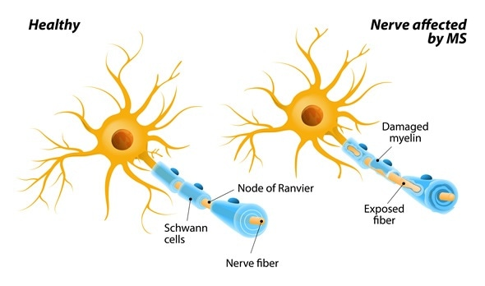
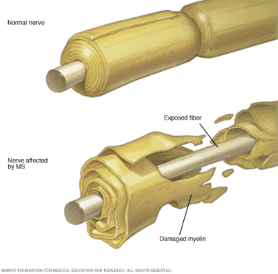
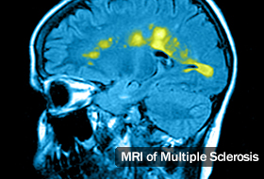
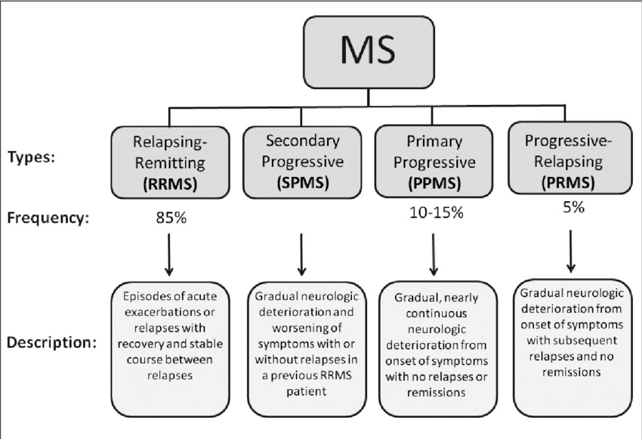
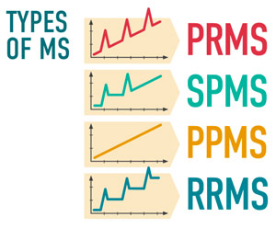
Multiple sclerosis
Multiple sclerosis (MS) involves an immune-mediated process in which an abnormal response of the body’s immune system is directed against the central nervous system (CNS: brain, spinal cord and optic nerves). Therefore MS is autoimmune inflammatory disease.
Within the CNS, the immune system causes inflammation that damages myelin — the fatty substance that surrounds and insulates the nerve fibers — as well as the nerve fibers themselves, and the specialized cells that make myelin. When myelin or nerve fibers are damaged or destroyed in MS, messages within the CNS are altered or stopped completely.
Damage to areas of the CNS may produce a variety of neurological symptoms that will vary among people with MS in four disease courses (types) and severity.
The cause of MS is not known, but it is believed to involve genetic susceptibility, abnormalities in the immune system and environmental factors that combine to trigger the disease.

Slide 3
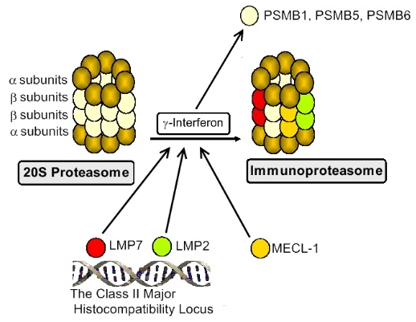
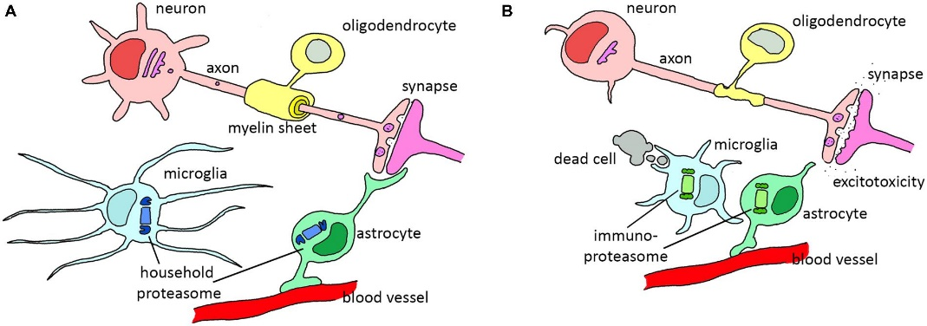
Possible links between proteasome and multiple sclerosis
Proteasomal system: Proteasomes, the multycatalytic protease complexes, play a critical role in the degradation of proteins via ATP/ubiquitin-dependent process or ubiquitin proteasome system, which plays a crucial role in immunity and its dysregulation and/or modulation may influence the development and progression of different diseases.
20S proteasome induction with interferon causes replacement of PSMB5, PSMB6 and PSMB1 by LMP2 (PSMB8), LMP7 (PSMB9) and MECL-1 (PSMB10) (multicatalytic endopeptidase complex subunit), respectively, and forms immunoproteasome. Expression of LMP2 and LMP7 genes is decreased in patients with autoimmune diseases.
The proteolytic activities of proteasomes are reduced in brain tissue of Multiple sclerosis patients. The 20S proteasome had been identified as a target of the humoral autoreactive immune response and a major autoantigen in MS patients.
Jansen et.al, Front. Mol. Neurosci., 2014
Notes:
Proteasomal system: Proteasomes, the multycatalytic protease complexes, play a critical role in the degradation of proteins via ATP/ubiquitin-dependent process or ubiquitin proteasome system, which plays a crucial role in immunity and its disregulation and/or modulation may influence the development and progression of different diseases.
Role of proteasomes in development of autoimmune diseases was obtained after discovery low molecular weight proteins (LMP) in the class II Major Histocompatibility Locus.
20S proteasome induction with interferon causes replacement of PSMB5, PSMB6 and PSMB1 by LMP2 (PSMB8), LMP7 (PSMB9) and MECL-1 (PSMB10) (multicatalytic endopeptidase complex subunit), respectively, and such forms immunoproteasome. In such proteasome turned out peptides that are better suited for MHC class I antigen presentation.
Expression of LMP2 and LMP7 genes is decreased in patients with autoimmune diseases.

Slide 4
Aim of the study
to find SNPs of proteasomal genes as possible biomarkers for multiple sclerosis in Latvian population

Slide 5
Materials and methods
Case/control study:
for genotyping 280 patients of multiple sclerosis (187 with relapsing-remitting MS and 93 with secondary progressive MS) and 305 controls
for gene expression 174 patients of multiple sclerosis.
Group | Subtype of MS | Gender | Number (Frequency,%, in group) | Age (Mean ± SD), year
Case or MS | RRMS+SPMS | All | 280 | 42,77 ± 11,10
 |  | Women | 198 (70,71) | 43,21 ± 10,87
 |  | Men | 82 (29,28) | 41,51 ± 11,65
 | RRMS | All | 187 | 38,80 ± 9,50
 |  | Women | 131 (70,05) | 39,42 ± 9,47
 |  | Men | 56 (29,95) | 37,30 ± 9,50
 | SPMS | All | 93 | 50,56 ± 9,88
 |  | Women | 67 (72,04) | 50,61 ± 9,53
 |  | Men | 26 (27,95) | 50,42 ± 10,92
Control | - | All | 305 | 38,80 ± 10,54
 |  | Women | 179 (58,69) | 38,78 ± 11,52
 |  | Men | 126 (41,31) | 37,22 ± 9,33
Notes:
To analyze the MS population and to be representative of all patients, 328 patients are required, assuming a 5% error rate or negative results, but with 6% error is need 239. Based on the Hong and Park (2012) analysis, it is estimated that 134 samples per group are required for one SNP (to reach OR 2.5). Accordingly, the number of samples calculated by the MS population corresponds to the need for a case / control study to analyze

Slide 6
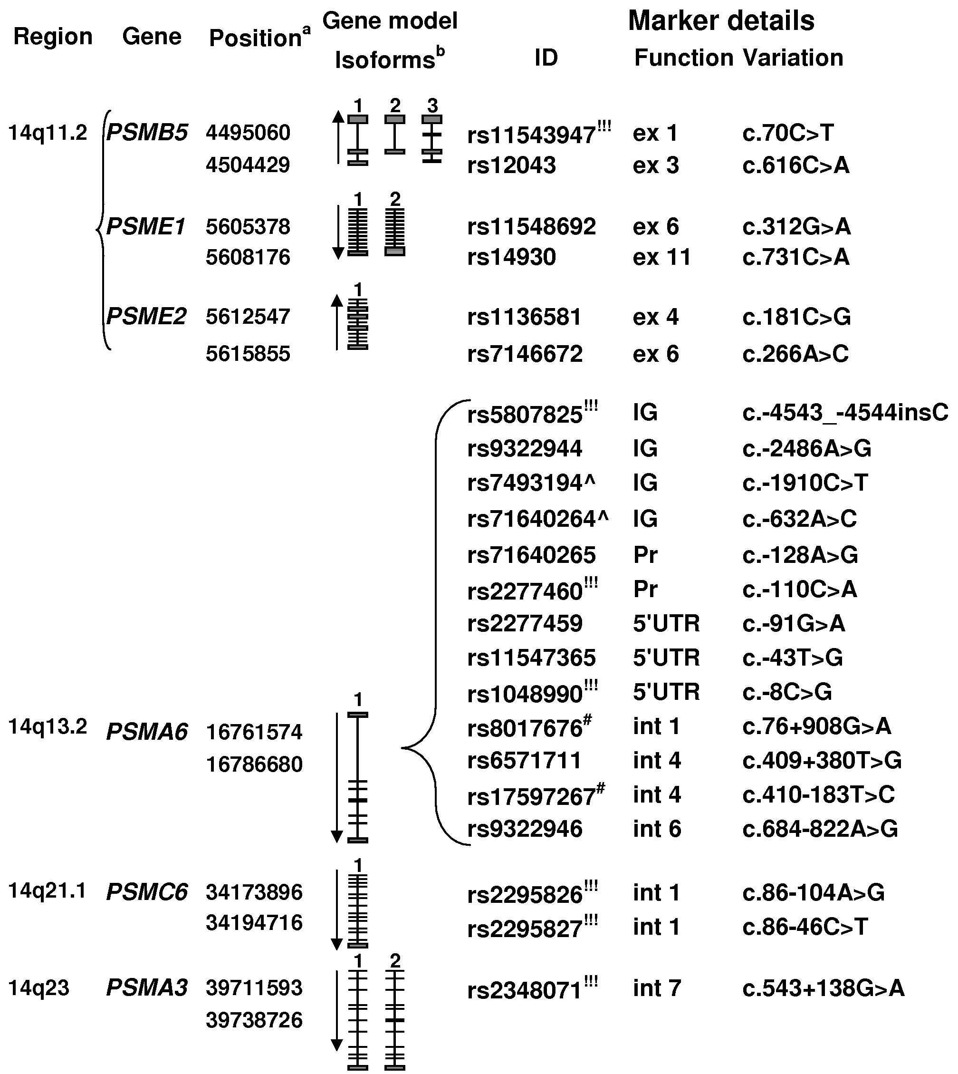
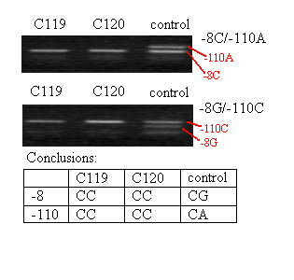
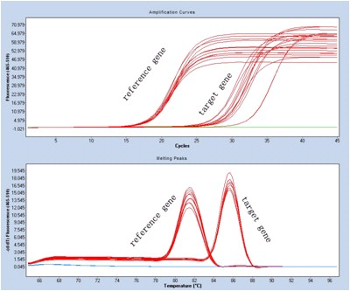
Materials and methods
Single nucleotide polymorphisms:
rs2277460: c.-110C>A of PSMA6 gene
rs1048990 c.-8C>G of PSMA6 gene
rs2295826 c.86-104A>G of PSMC6 gene
rs2295827 c.86-46C>T of PSMC6 gene
Analyze methods
For genotyping was used allele specific PCR and restriction enzyme site polymorphism method.
For gene expression was used qPCR
Notes:
To analyze the MS population and to be representative of all patients, 328 patients are required, assuming a 5% error rate or negative results, but with 6% error is need 239. Based on the Hong and Park (2012) analysis, it is estimated that 134 samples per group are required for one SNP (to reach OR 2.5). Accordingly, the number of samples calculated by the MS population corresponds to the need for a case / control study to analyze

Slide 7
Materials and methods
Statistic methods with IBM SPSS Statistics v.25
For genotyping results was analyzed :
Hardi-Weinberg equilibrium by using test of χ² criteria or Fisher exact test between obtained and expected values;
commitment between SNPs by using linkage disequilibrium test;
difference between groups by using test of χ² criteria (Pirson χ² test) or Fisher exact test (with Monte Karlo permutation);
clinical significance of differences by using Odds ratio (OR) with additive and multiplicative model.
For gene expression results was analyzed:
normal-distribution by using Kolmogorov-Smirnov (if N >50) or Shapiro – Wilk (N < 50) tests;
difference between groups by using T test or Mann Whitney U test for two groups or ANOVA or Kruskal-Walis test for more than two groups;
for association with genotyping results by using eta (η).

Slide 8
Results of the study
Notes:
There weren’t any association between MS and SNP of -8 of PSMA6 or rs1048990

Slide 9
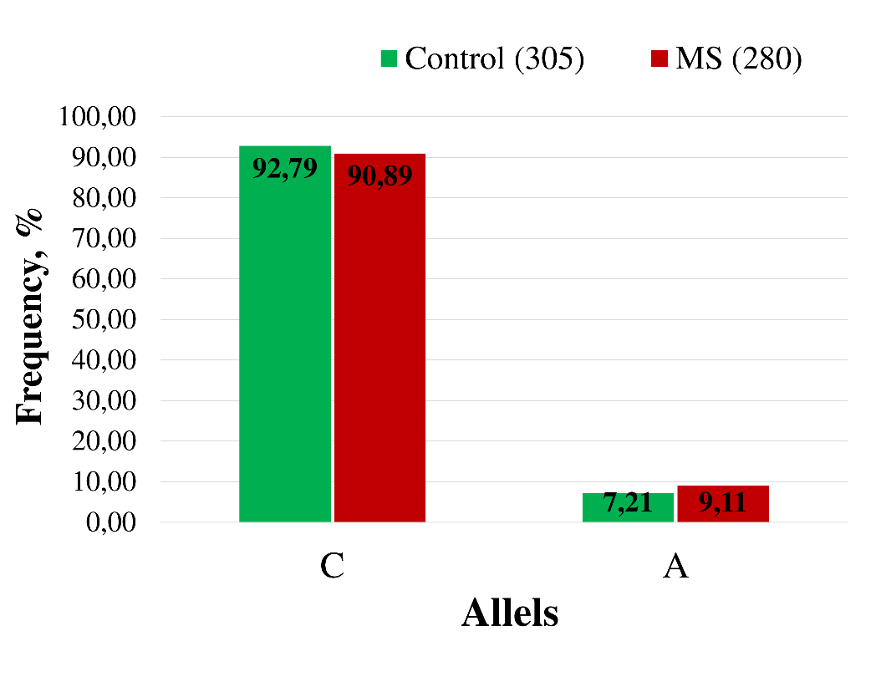
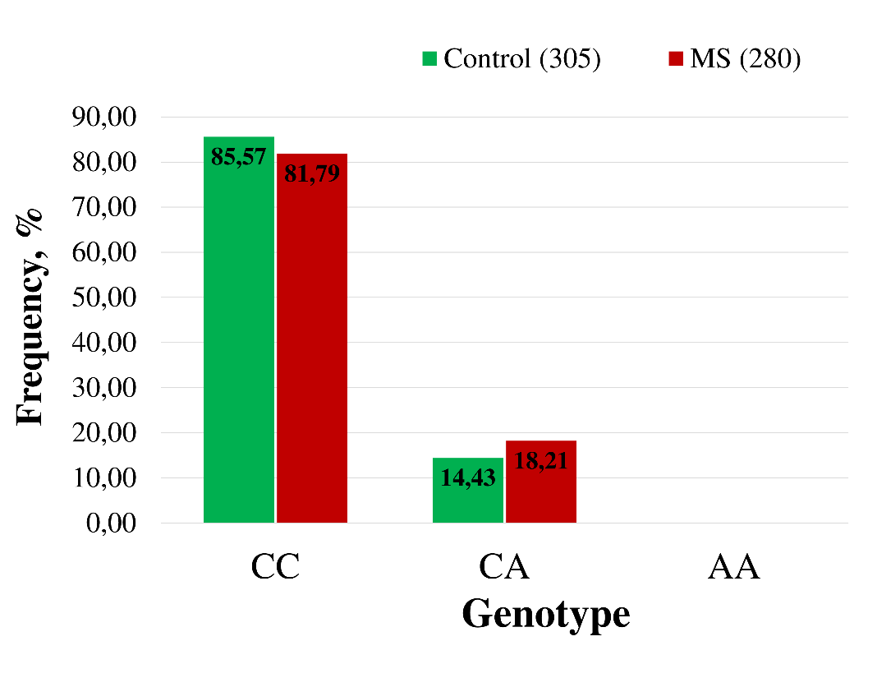
Case/control study of c.-110C>A of PSMA6
Alelle: C vs A
Genotype: CC vs CA
No statistically significant difference of frequencies of alleles and genotypes of rs2277460 or c-110C>A of PSMA6 in control and case samples.
Notes:
Izmantojot kontingences tabulas hi2 metodi, konstatējām, ka PSMA6 gēna -110 pozīcijas SNP gan alēļu, gan genotipu līmenī ir statistiski ticami asociācija ar MS pacientēm jeb MS sieviešu grupu, salīdzinot ar kontroles sieviešu grupu.
Ja no MS grupas tiek izdalīti abi analizētie subtipi, tad konstatējām, ka RRMS gadījumā asociācija zūd, bet SPMS gadījumā palielinās tās nozīmīgums.

Slide 10
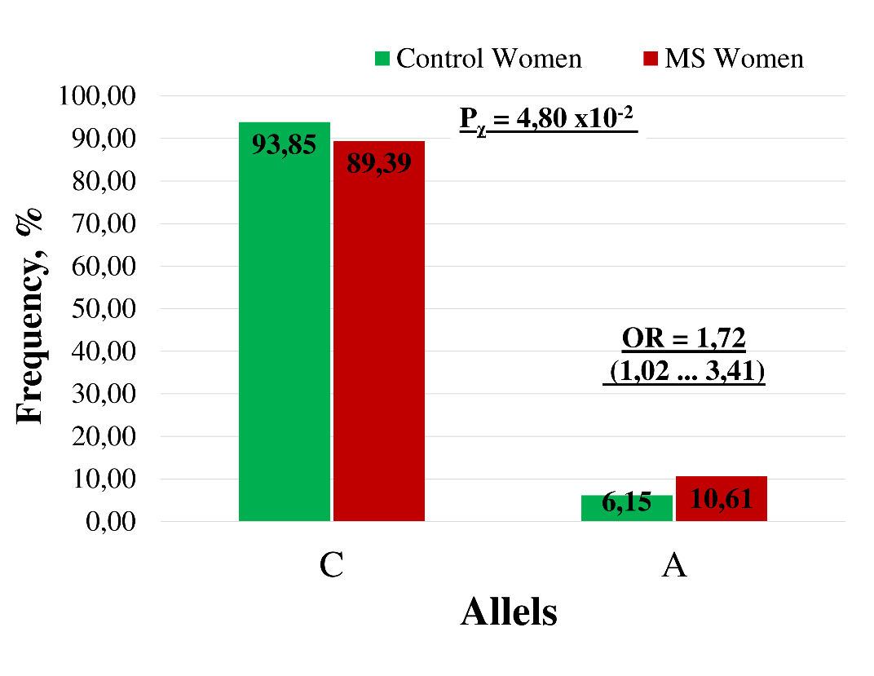
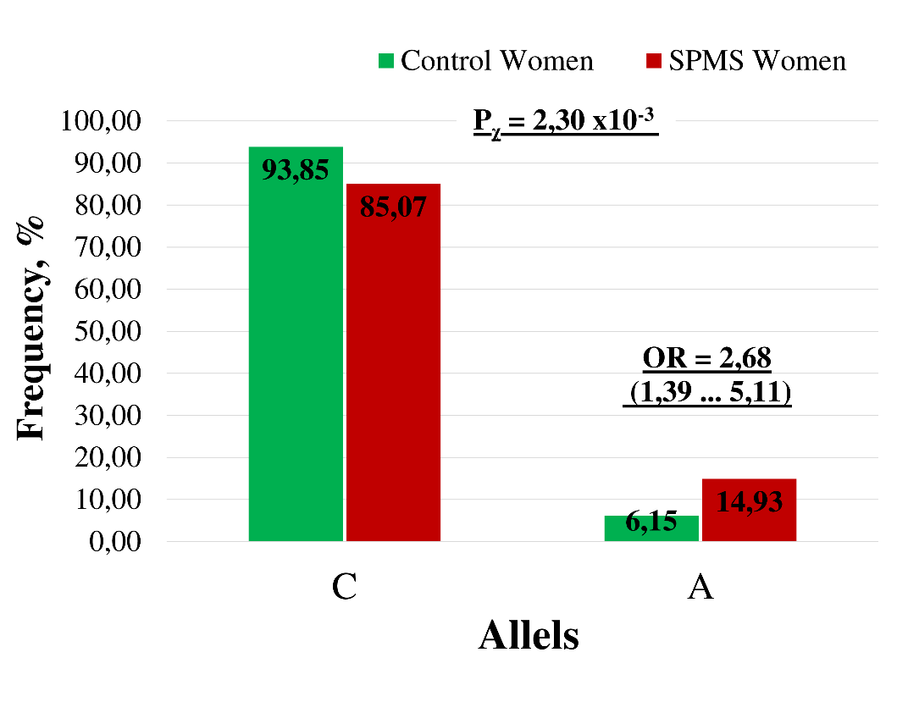
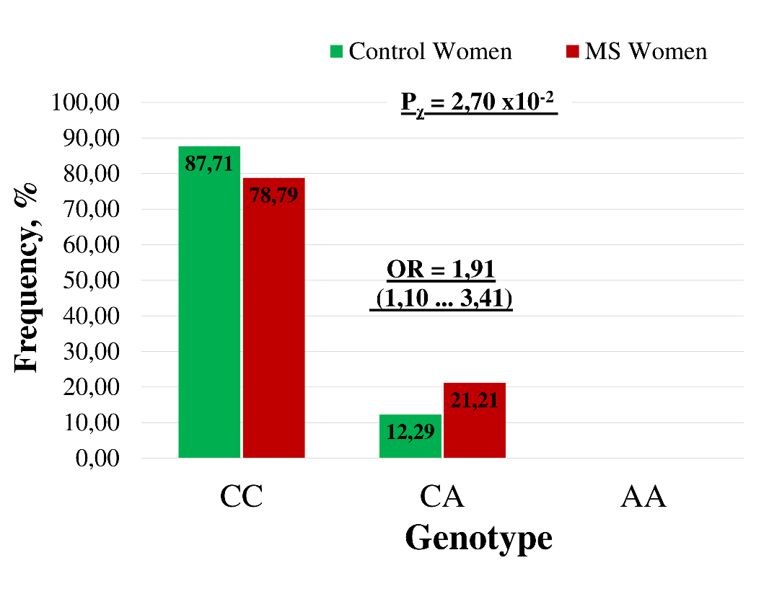
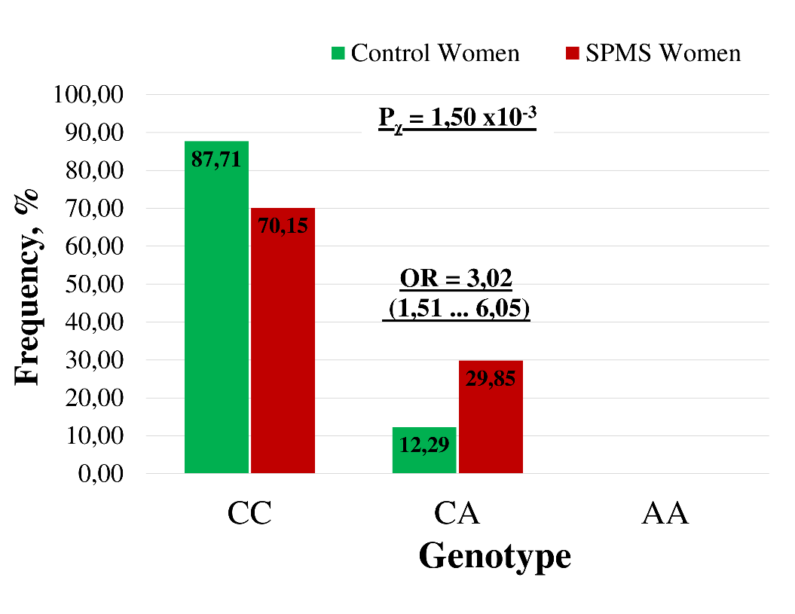
Case/control study of c.-110C>A of PSMA6
Alelle: C vs A
Genotype: CC vs CA
Rear allele and heterozygot genotype of rs2277460 or c-110C>A of PSMA6 are risk form for MS women patients, especially, for SPMS type.
Notes:
Izmantojot kontingences tabulas hi2 metodi, konstatējām, ka PSMA6 gēna -110 pozīcijas SNP gan alēļu, gan genotipu līmenī ir statistiski ticami asociācija ar MS pacientēm jeb MS sieviešu grupu, salīdzinot ar kontroles sieviešu grupu.
Ja no MS grupas tiek izdalīti abi analizētie subtipi, tad konstatējām, ka RRMS gadījumā asociācija zūd, bet SPMS gadījumā palielinās tās nozīmīgums.

Slide 11
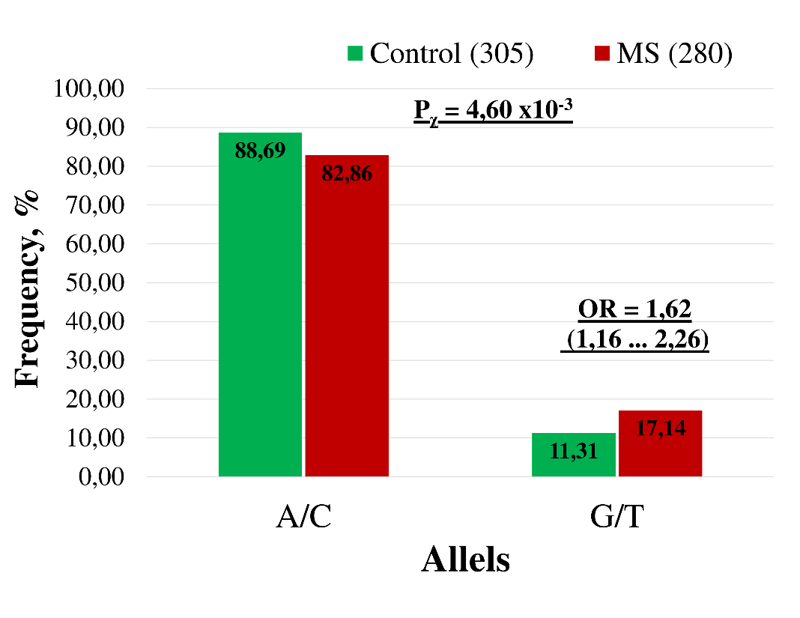
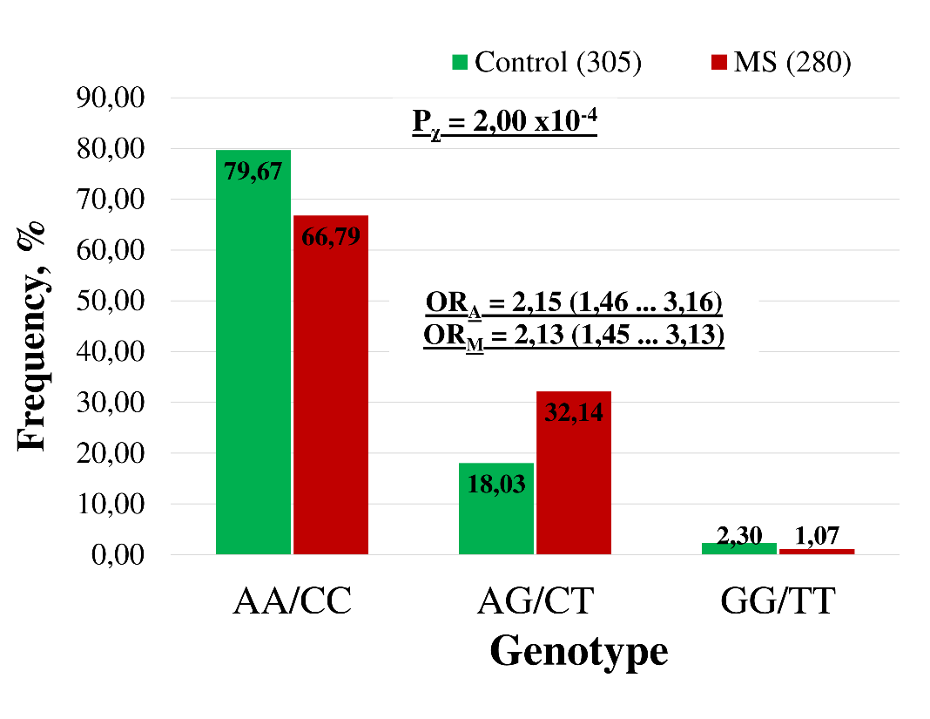
Case/control study of PSMC6
rs2295826/rs2295827 of PSMC6 are in complete linkage disequilibrium in both groups of Latvian population
Alelles: G/T vs A/C
Genotype
There is statistically significant association between SNPs of PSMC6 and multiple sclerosis.
Notes:
Both analyzed SNPs of PSMc6 genes were in complete linkage disequilibrium in both: control and MS, groups of Latvian population. Therefor we can look on frequencies of one SNP and know the frequency of other.

Slide 12
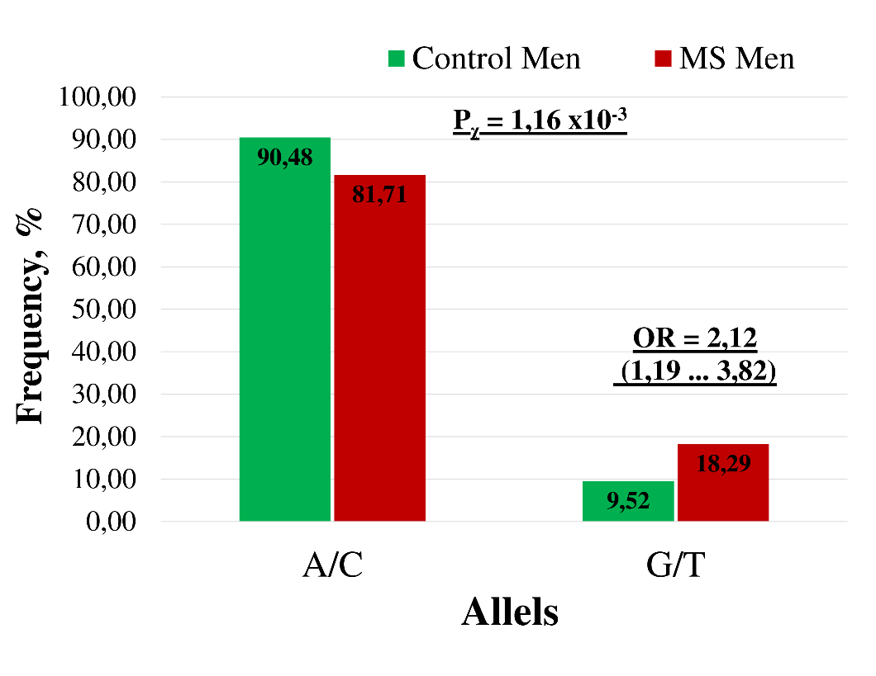
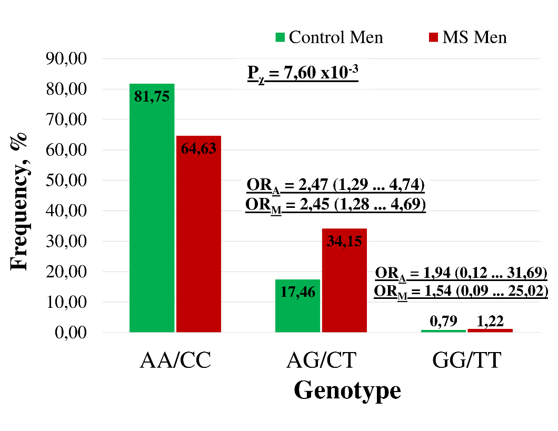
Case/control study of PSMC6
Gender
Alelles: G/T vs A/C
Genotype

Slide 13
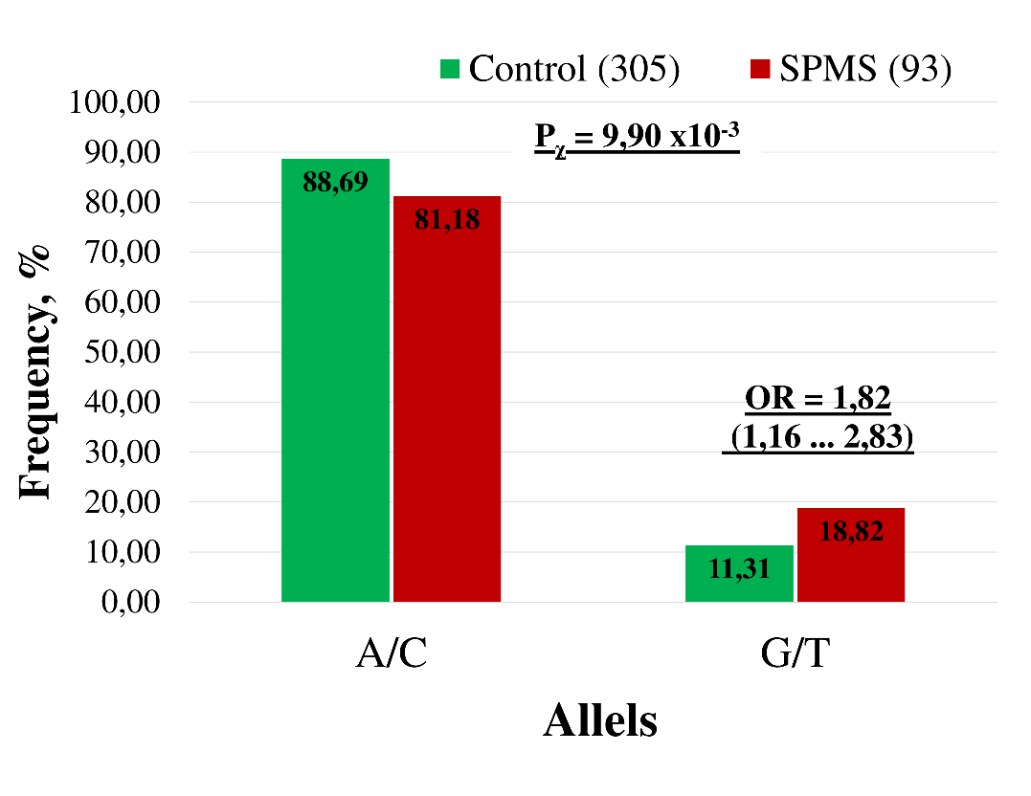
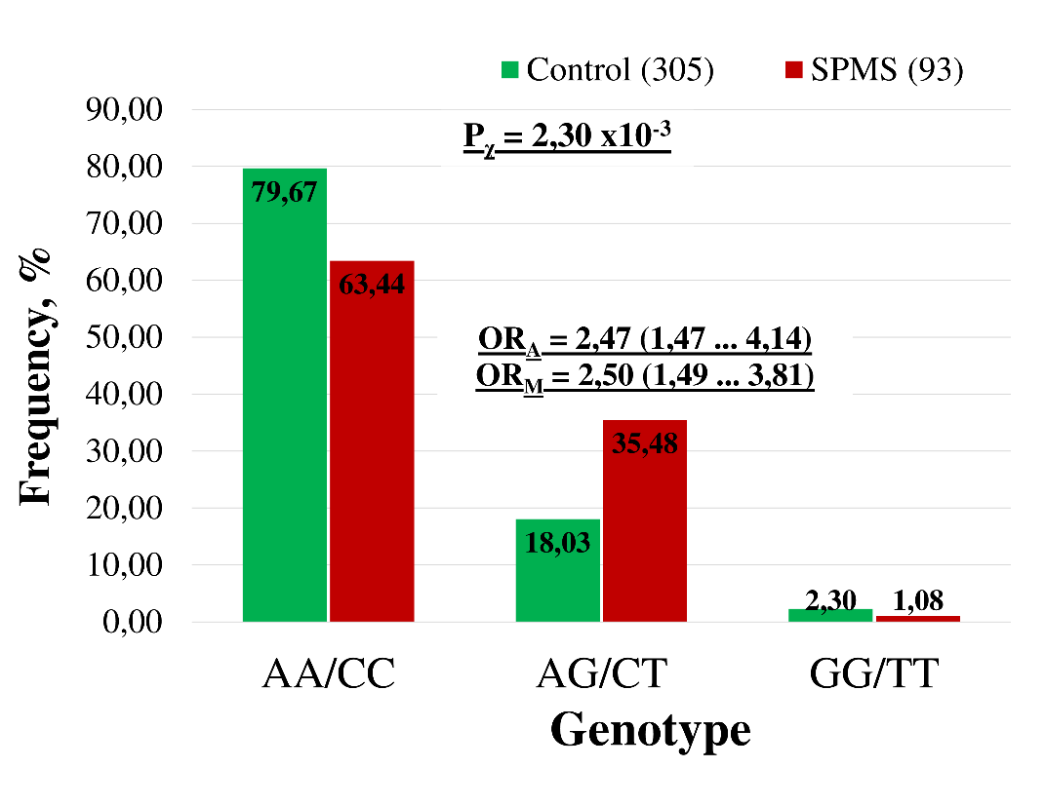
Case/control study of PSMC6
MS subtype
Alleles: G/T vs A/C
Genotype

Slide 14
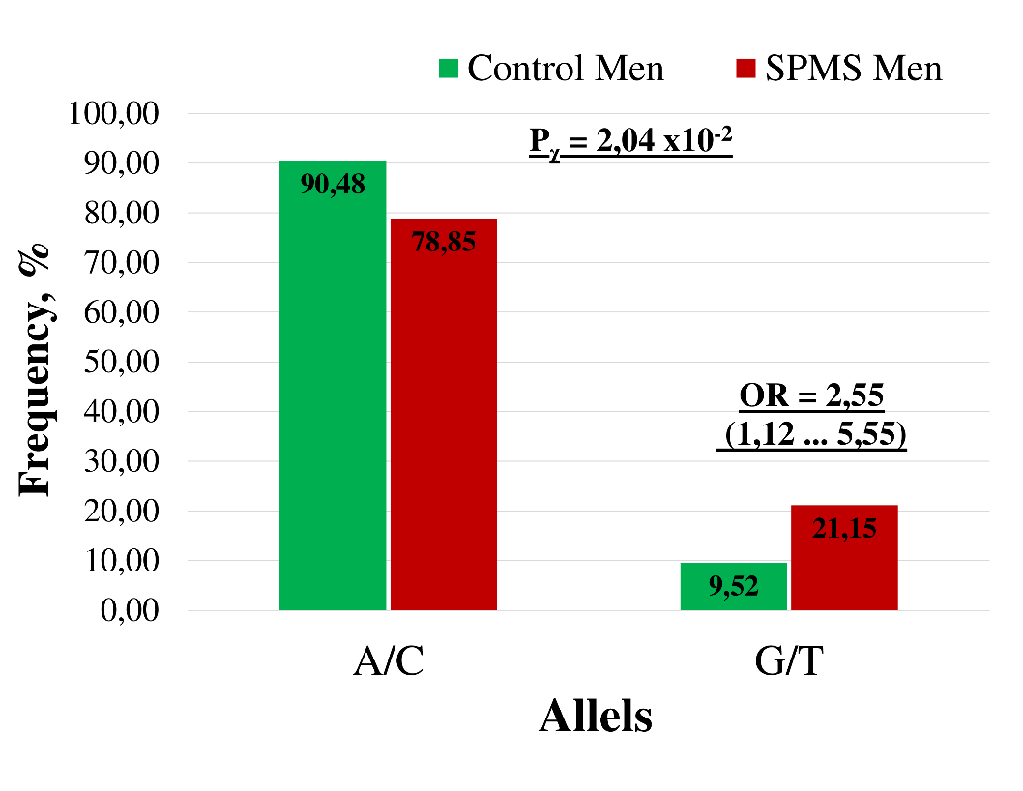
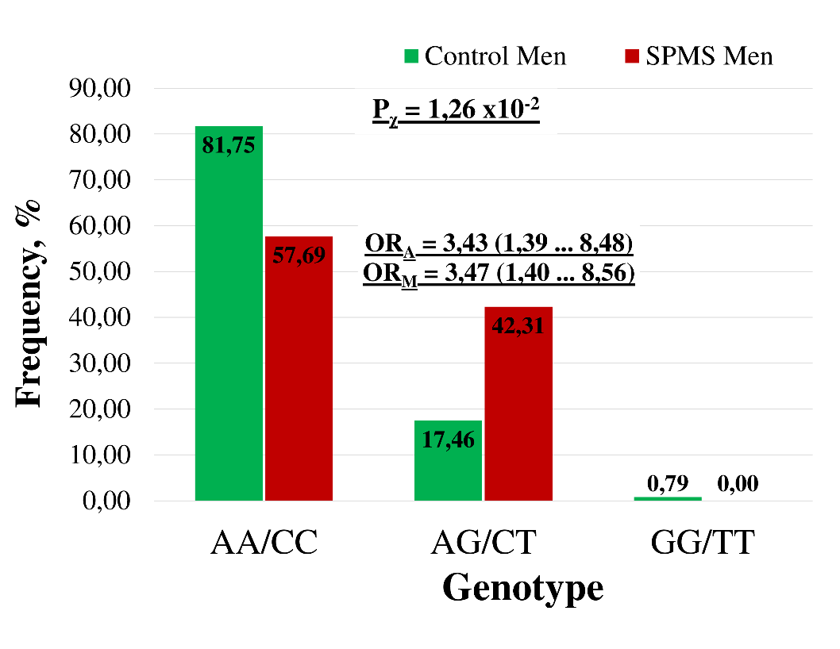
Case/control study of PSMC6
Gender and MS subtype
Alleles: G/T vs A/C
Genotype
Rear allele and heterozygot genotype of rs2295826/rs2295827 of PSMC6 are risk forms for MS men patients, especially, for SPMS type.

Slide 15
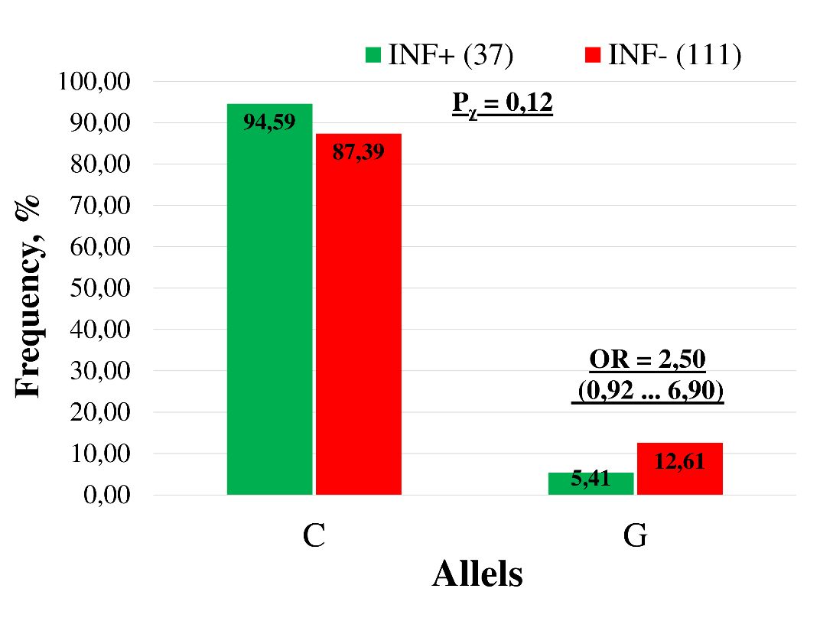
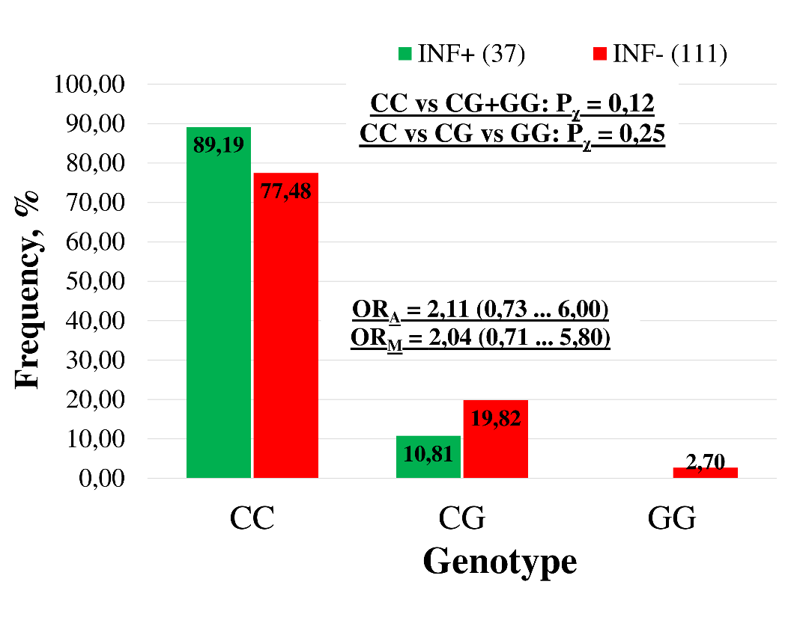
Cohort study of response to INF therapy
c.-8C>G of PSMA6 (rs1048990)
Alleles: C vs. G
Genotypes
Rear allele and heterozygote genotype of rs1048990 of PSMA6 can be risk form for respond to interferon therapy of MS patients.
Notes:
148 patients from all had different kind therapy of INF. From which 37 had positive result or there was reached positive No evidence of disease activity (NEDA) of MS.

Slide 16
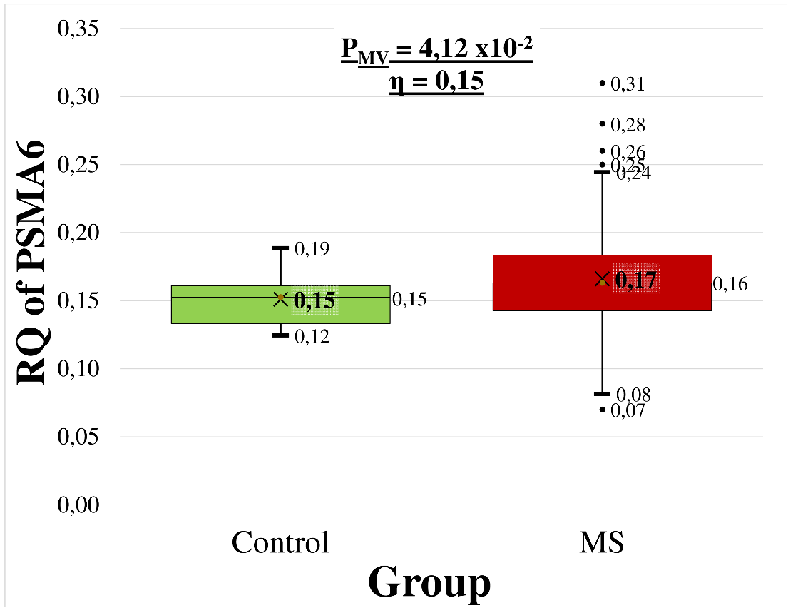
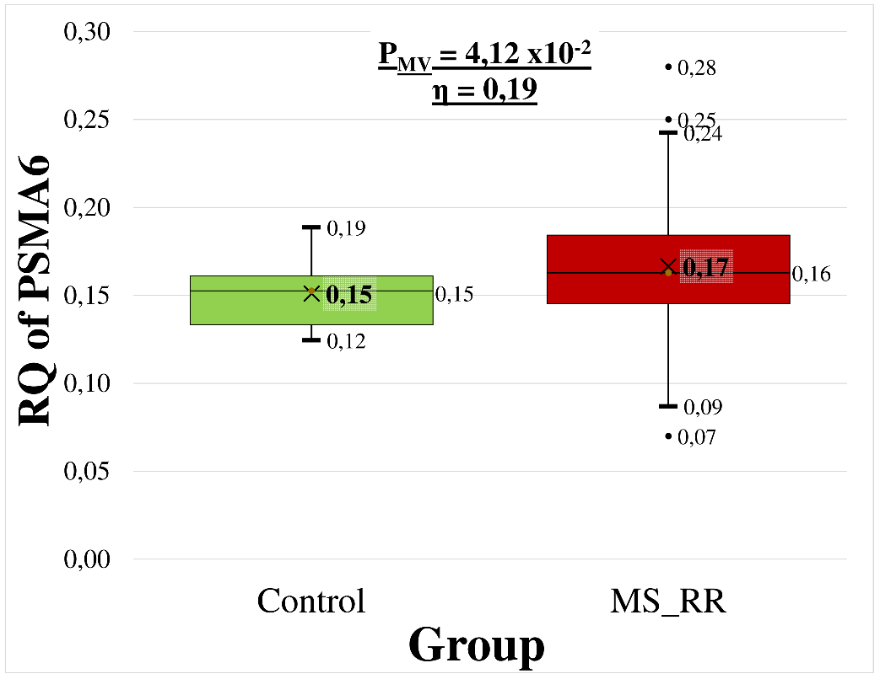
Expression level of PSMA6
Control vs MS
Control vs RR MS type
Expression of PSMA6 gene is statistically significant higher for MS patients

Slide 17
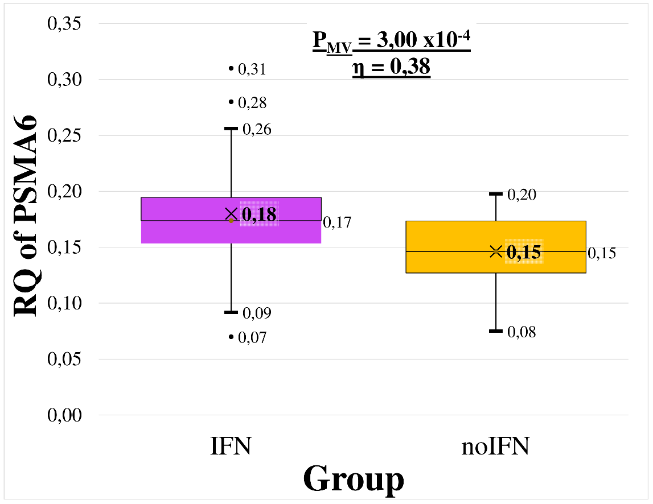
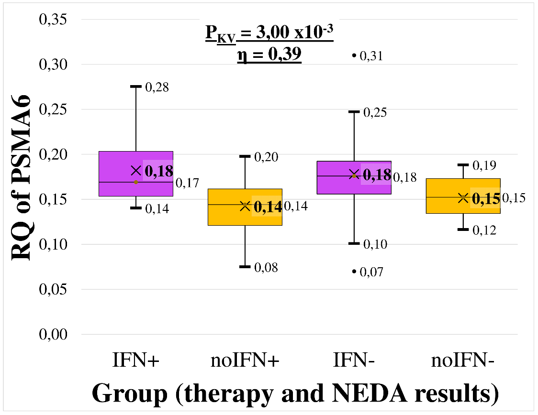
Expression level of PSMA6
Inteferon therapy for MS patients
Expression of PSMA6 gene is statistically significant higher for MS patients with IFN therapy

Slide 18
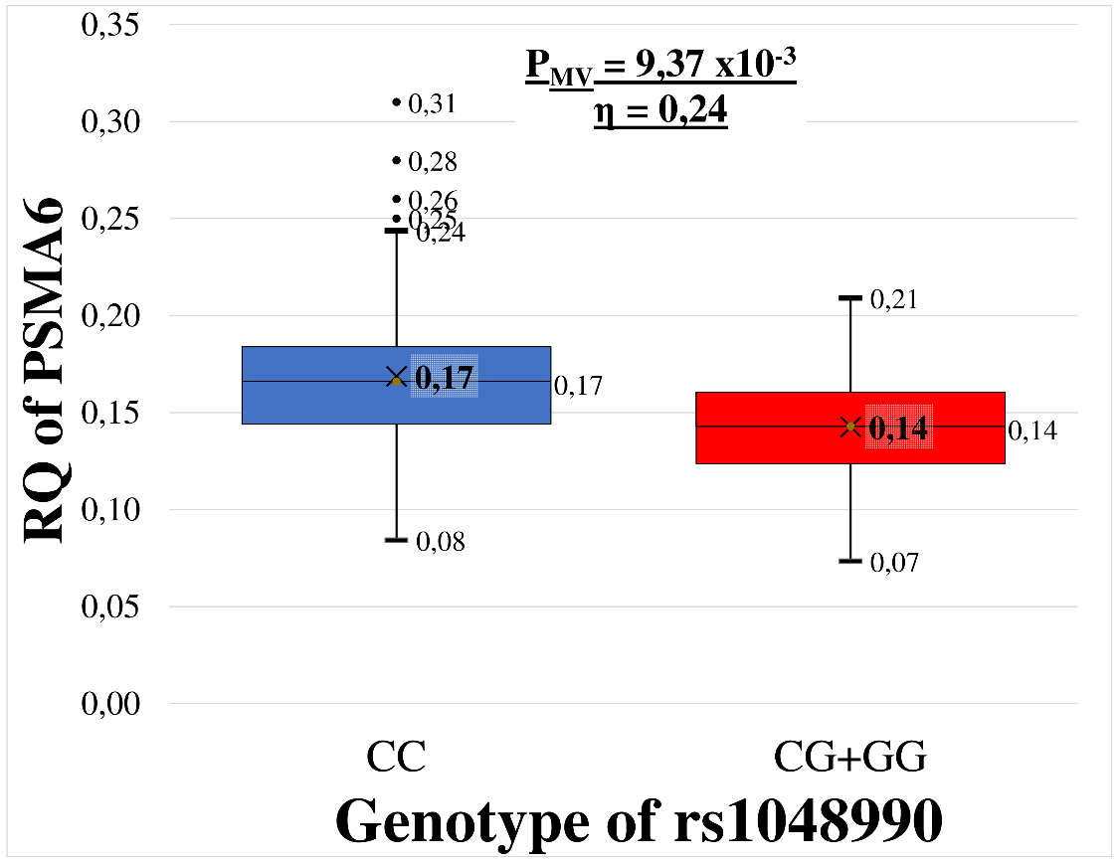
Expression level of PSMA6
rs1048990 or c-8C>A of PSMA6 for MS patients
MS patients
MS patients women

Slide 19
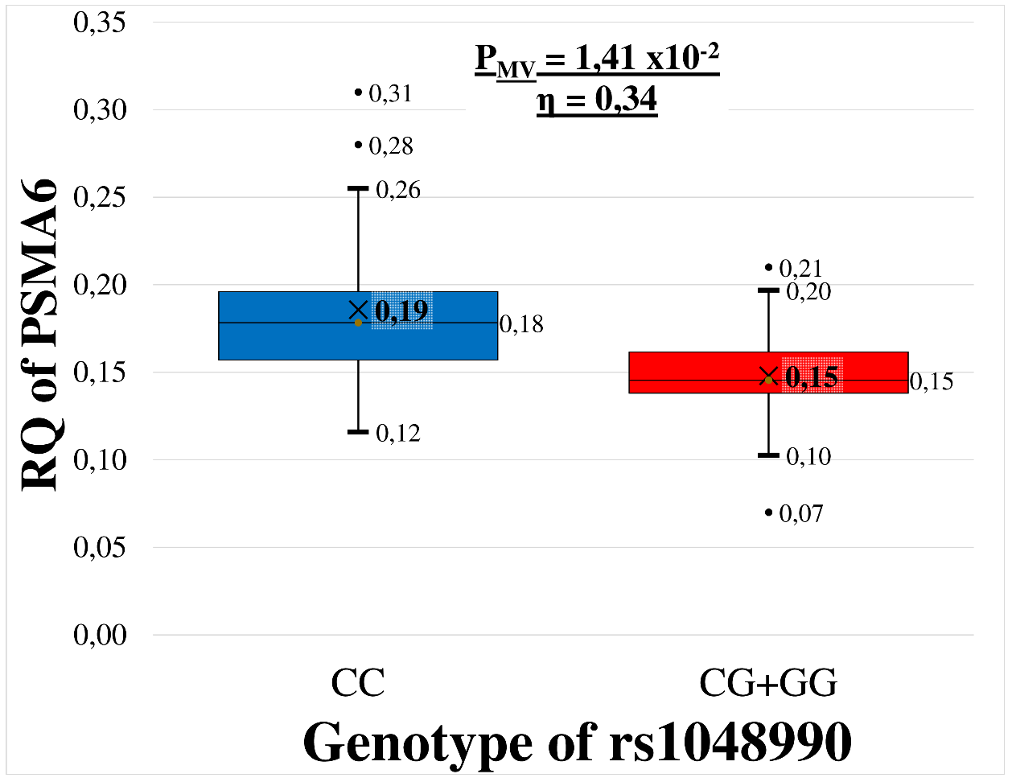
Expression level of PSMA6
MS patients SP type
Heterozygote genotype of rs1048990 or c-8C>A of PSMA6 for MS women or SP type patients are risk form for expression of PSMA6 gene.

Slide 20
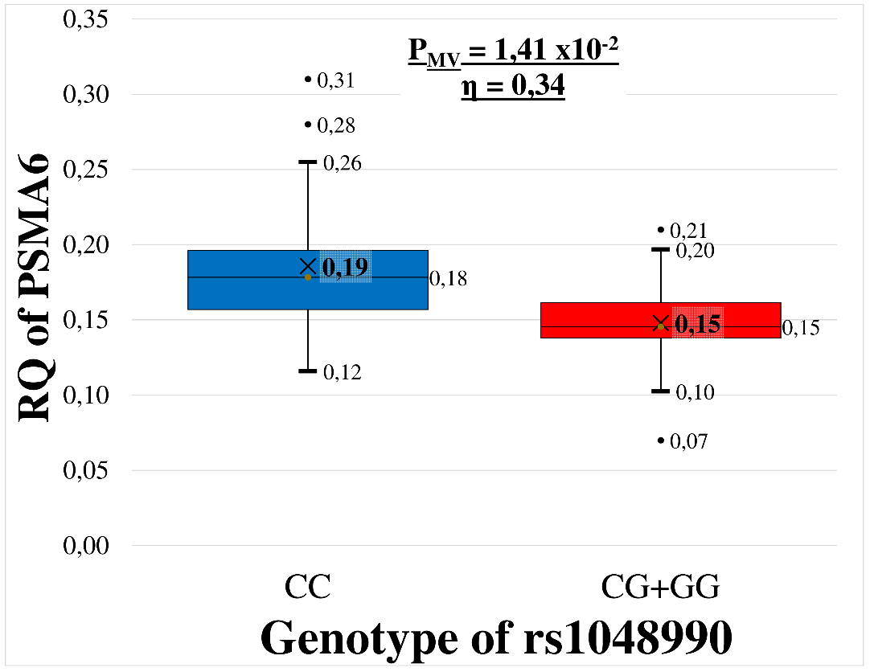
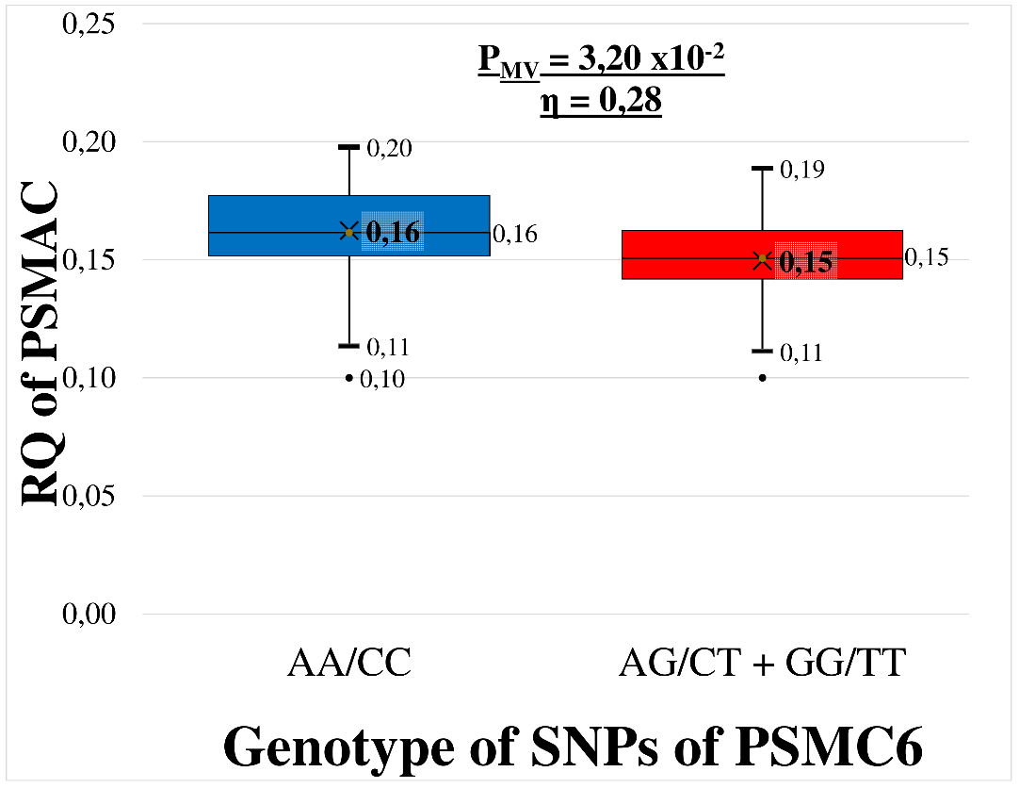
Expression level of genes
MS patients with Interferon therapy
Heterozygotes genotype of rs1048990 of PSMA6 and of SNPs of PSMC6 form for MS patients with interferon therapy are risk for expression of genes.

Slide 21
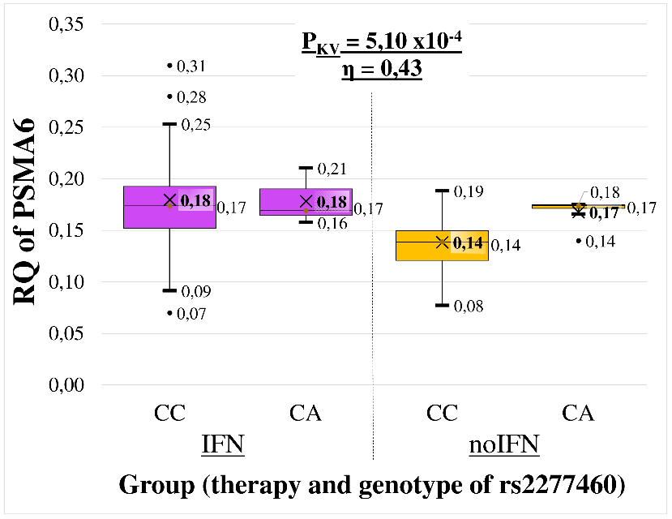
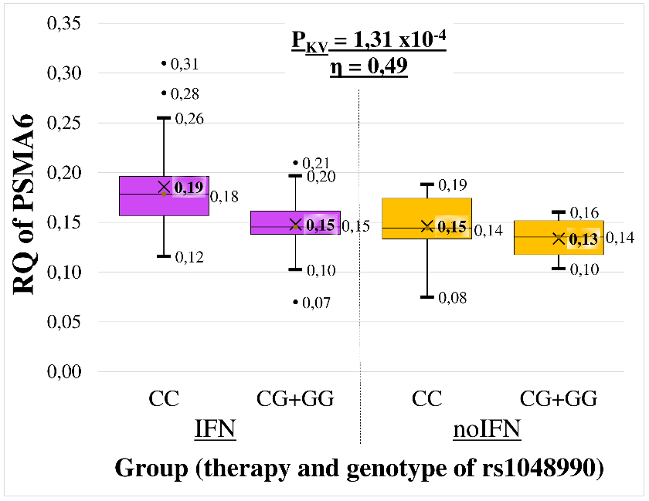
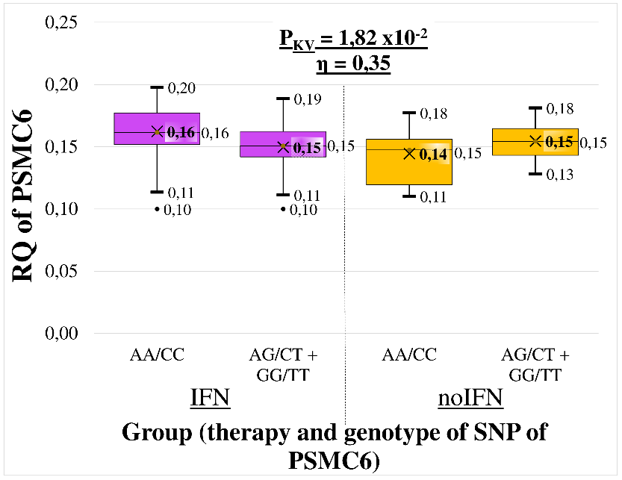
Expression level of genes
MS patients with Inteferon therapy

Slide 22
Conclusions
We provide evidence that variations of proteasomal genes: PSMA6 and PSMC6, may contribute to the risk of multiple sclerosis in Latvians.
Results suggest that IFN therapy increases transcription of genes of 20S proteasome α type subunits.
Our results prove that the investigated polymorphisms potentially may be usable biomarkers for MS risk in clinical practice.

Slide 23
Thank you for your attention! ☺
The study was funded from the European Regional Development Fund project No. 1.1.1.1/16/A/016 "Identification of proteasome related genetic, epigenetic and clinical markers for multiple sclerosis”.

