Slide 1
Meta and bioinformatics analysis of SNP of proteasome genes as possible molecular markers for multiple sclerosis case/control study in Latvian population
I. Trapina, Dr.med.
Genomica and Bioinformatic
Institute of Biology, University of Latvia
Daugavpils, 2019

Slide 2
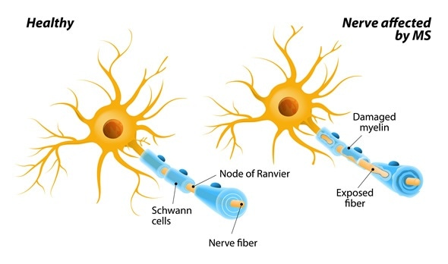
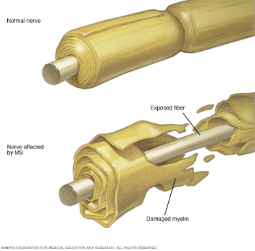
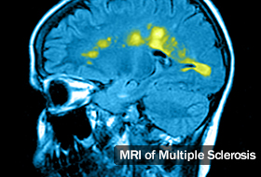
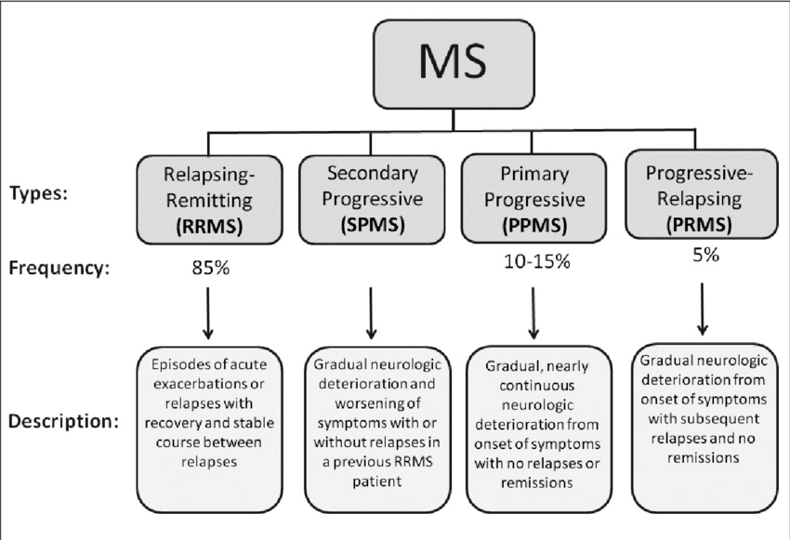
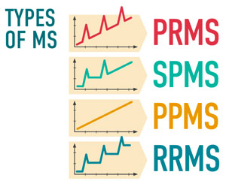
Multiple sclerosis
Multiple sclerosis (MS) involves an immune-mediated process in which an abnormal response of the body’s immune system is directed against the central nervous system (CNS: brain, spinal cord and optic nerves). Therfore MS is autoimmune inflammatory disease.
Within the CNS, the immune system causes inflammation that damages myelin — the fatty substance that surrounds and insulates the nerve fibers — as well as the nerve fibers themselves, and the specialized cells that make myelin. When myelin or nerve fibers are damaged or destroyed in MS, messages within the CNS are altered or stopped completely.
Damage to areas of the CNS may produce a variety of neurological symptoms that will vary among people with MS in four disease courses (types) and severity.
The cause of MS is not known, but it is believed to involve genetic susceptibility, abnormalities in the immune system and environmental factors that combine to trigger the disease.

Slide 3
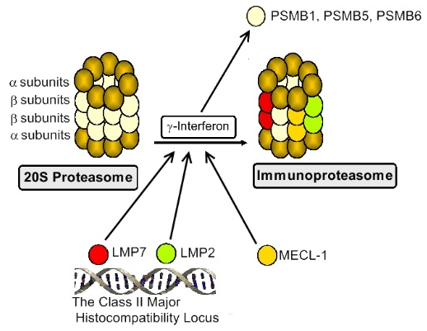
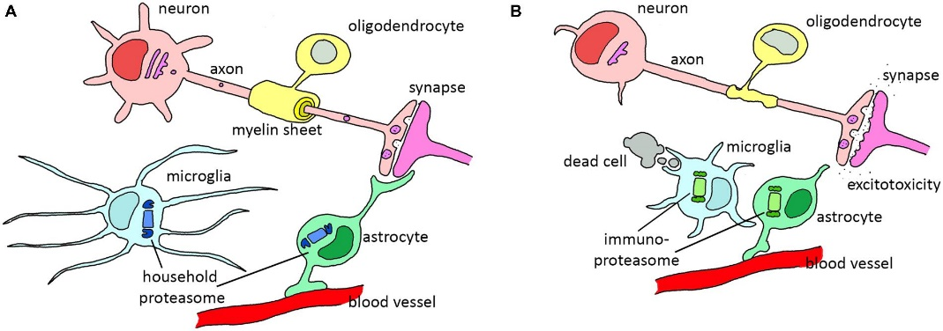
Possible links between proteasome and multiple sclerosis
Proteasomal system: Proteasomes, the multycatalytic protease complexes, play a critical role in the degradation of proteins via ATP/ubiquitin-dependent process or ubiquitin proteasome system, which plays a crucial role in immunity and its disregulation and/or modulation may influence the development and progression of different diseases.
20S proteasome induction with interferon causes replacement of PSMB5, PSMB6 and PSMB1 by LMP2 (PSMB8), LMP7 (PSMB9) and MECL-1 (PSMB10) (multicatalytic endopeptidase complex subunit), respectively, and forms immunoproteasome. Expression of LMP2 and LMP7 genes is decreased in patients with autoimmune diseases.
The proteolytic activities of proteasomes are reduced in brain tissue of Multiple sclerosis patients. The 20S proteasome had been identified as a target of the humoral autoreactive immune response and a major autoantigen in MS patients.
Jansen et.al, Front. Mol. Neurosci., 2014
Notes:
Proteasomal system: Proteasomes, the multycatalytic protease complexes, play a critical role in the degradation of proteins via ATP/ubiquitin-dependent process or ubiquitin proteasome system, which plays a crucial role in immunity and its disregulation and/or modulation may influence the development and progression of different diseases.
Role of proteasomes in development of autoimmune diseases was obtained after discovery low molecular weight proteins (LMP) in the class II Major Histocompatibility Locus.
20S proteasome induction with interferon causes replacement of PSMB5, PSMB6 and PSMB1 by LMP2 (PSMB8), LMP7 (PSMB9) and MECL-1 (PSMB10) (multicatalytic endopeptidase complex subunit), respectively, and such forms immunoproteasome. In such proteasome turned out peptides that are better suited for MHC class I antigen presentation.
Expression of LMP2 and LMP7 genes is decreased in patients with autoimmune diseases.

Slide 4
Aim of the study
To determine the prevalence and possible functionality SNPs of proteasome gene to analyze their usability as molecular markers for multiple sclerosis binding study in the Latvian population.

Slide 5
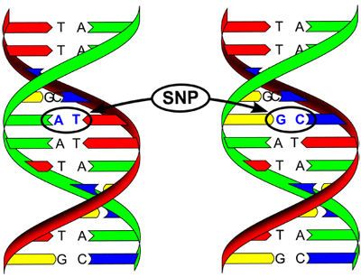
Materials and methods
Six SNPs of proteasomal genes:
PSMB8 (LMP7) - proteasome subunit beta 8:
rs2071543 > NM_004159.4:c.135+427C>A (Gln49Lys)
rs9357155 > NM_148919.3:c.537+63C>T (G>A)
rs9275596 > NT_167246.1:g.4138777T>C
PSMB9 (LMP2) - proteasome subunit beta 9
rs17587 > NM_002800.4:c.179G>A
PSMD9 - proteasome 26S subunit, non-ATPase 9
rs74421874 > NM_002813.6:c.454-460G>A
rs3825172 > NM_002813.6:c.454-437C>T
Meta analyze of scientific literature
Bioinformatical tools:
Transcription factor binding site > MatInspector (http://www.genomatix.de) with identity 1,00 of core and >0,85 of matrix
DNA bendabilty > bent.it (Vlahovicek et al., 2003; http://pongor.itk.ppke.hu/dna/bend_it.html#/bendit_form)
DNA and/or RNA secondary structure > Mfold (Zuker 2003, http://unafold.rna.albany.edu/?q=mfold/DNA-Folding-Form)

Slide 6
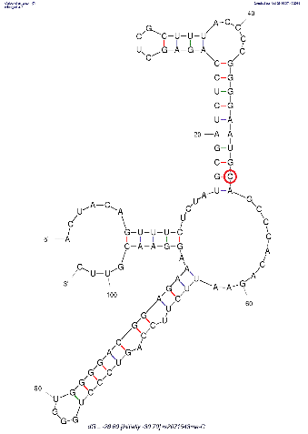
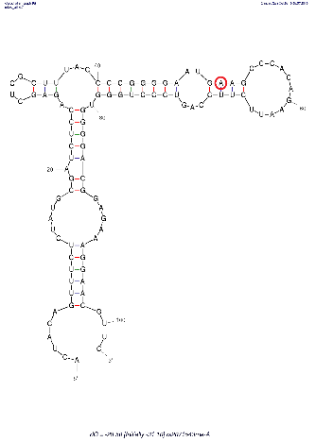
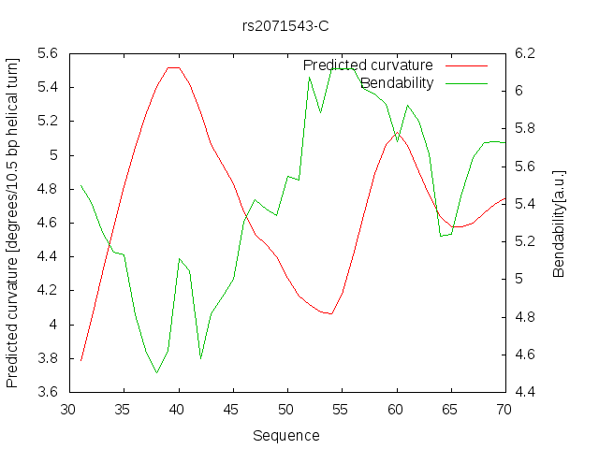
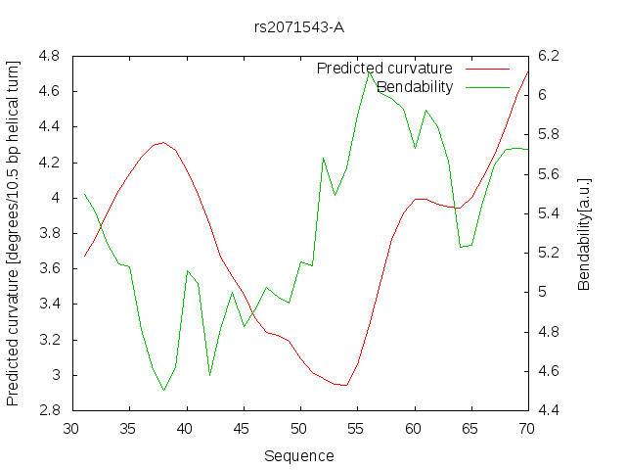
Results
PSMB8 - rs2071543: NM_004159.4:c.135+427C>A (Gln49Lys)
MAF in EUR: 0.15
Transcription factor binding site
C
A
RNA secondary structure
C
A
DNA bendabilty (green line) in areal decreases at change of nucleotide C>A

Slide 7
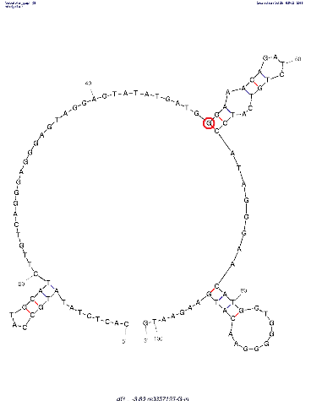
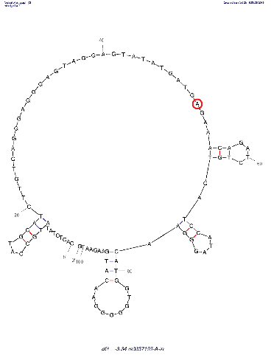
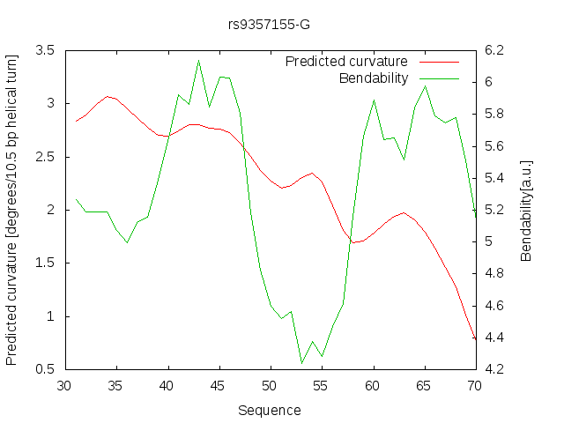
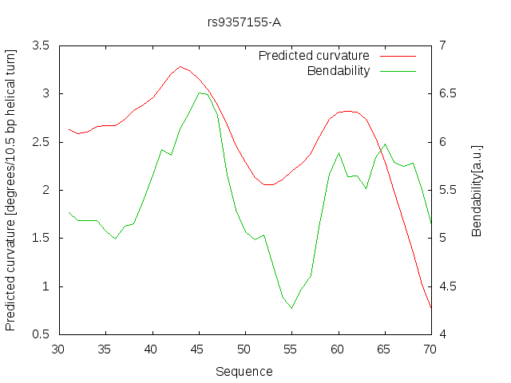
Results
PSMB8 - rs9357155: NM_148919.3:c.537+63C>T (G>A)
MAF in EUR: 0.31
Transcription factor binding site
G
A
DNA secondary structure
G
A
DNA bendabilty (green line) in areal increases at change of nucleotide G>A

Slide 8
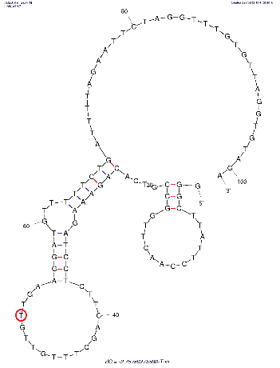
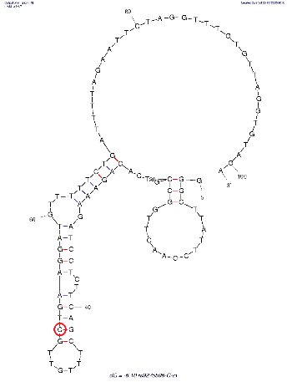
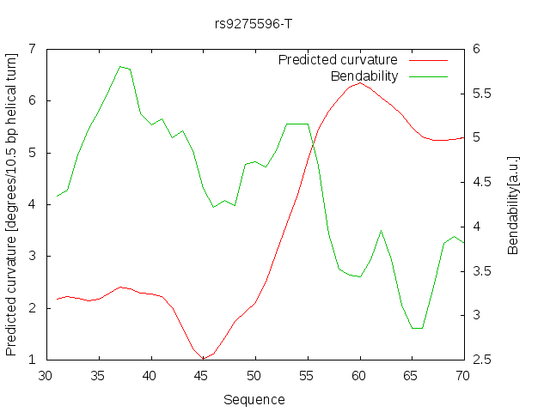
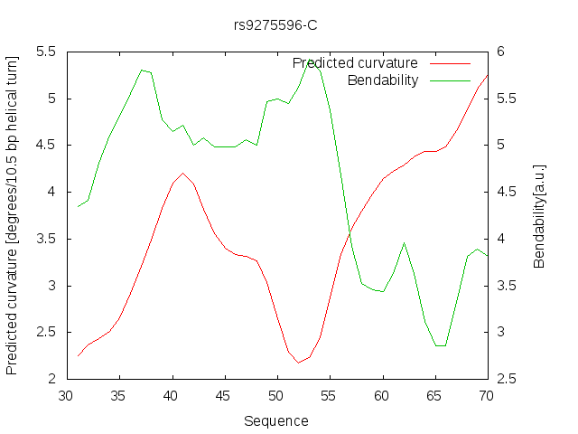
Results
PSMB8 - rs9275596 > NT_167246.1:g.4138777T>C
MAF in EUR: 0.14
Transcription factor binding site
T
C
DNA secondary structure
T
C
DNA bendabilty (green line) in areal increases at change of nucleotide T>C

Slide 9
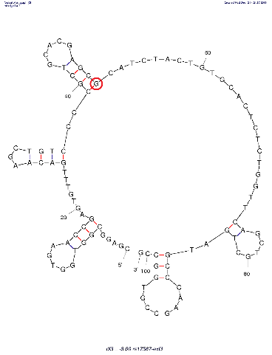
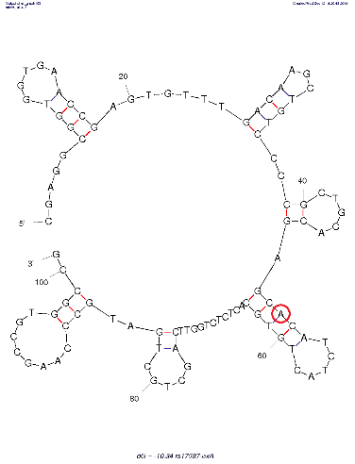
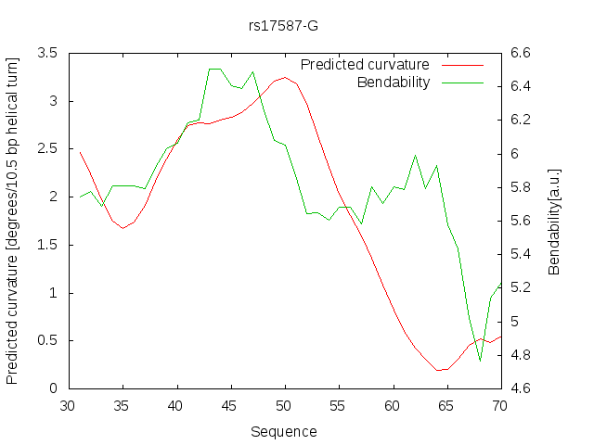
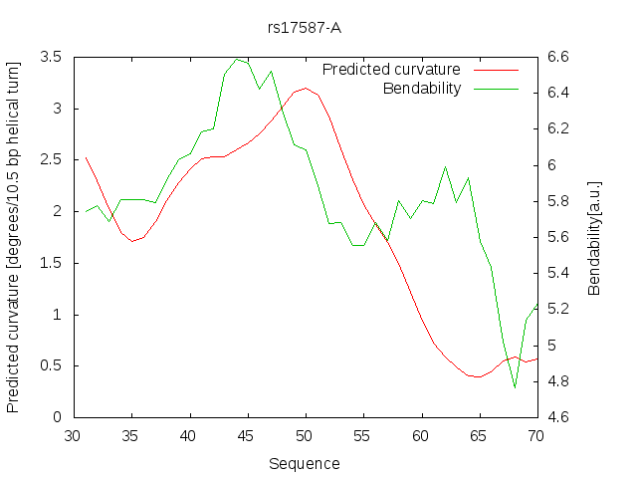
Results
PSMB9 - rs17587 > NM_002800.4:c.179G>A
MAF in EUR: 0.27
Transcription factor binding site
G
A
DNA secondary structure
G
A
DNA bendabilty (green line) in areal no difference at change of nucleotide G>A

Slide 10
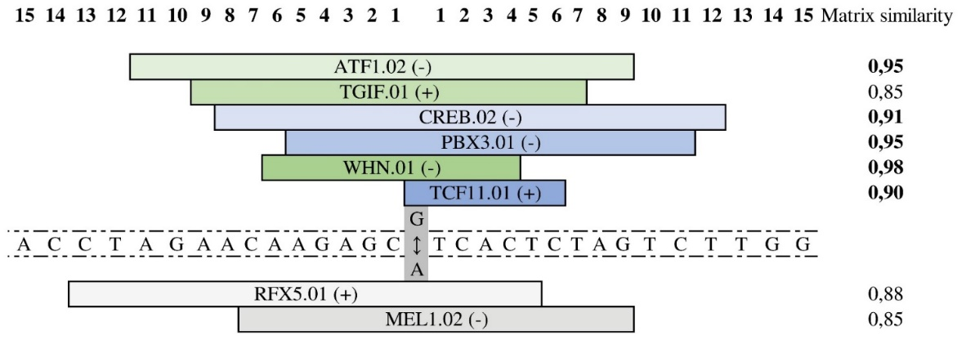
Results
PSMD9 - rs74421874: NM_002813.6:c.454-460G>A and rs3825172: NM_002813.6:c.454-437C>T
in complete linkage disequilibrium with MAF in EUR: 0.31 for both SNPs (between are 23 bp)
Transcription factor binding site
rs74421874
rs3825172

Slide 11
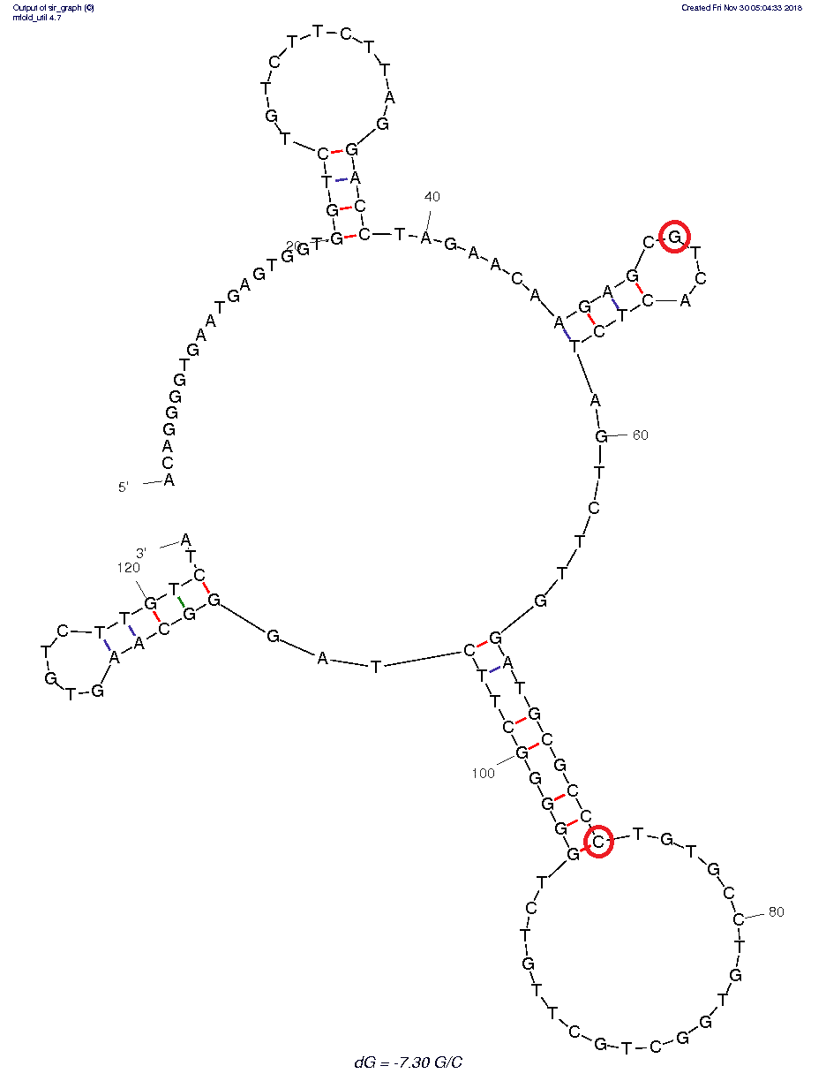
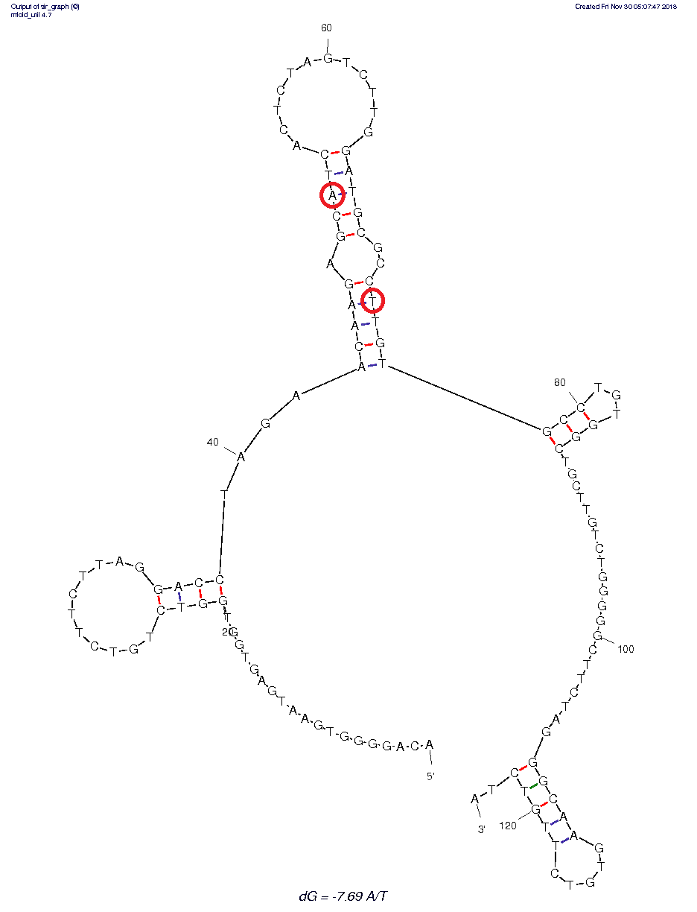
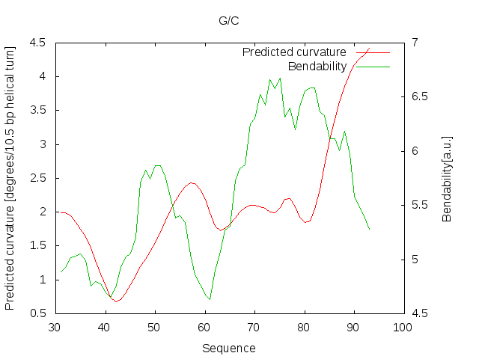
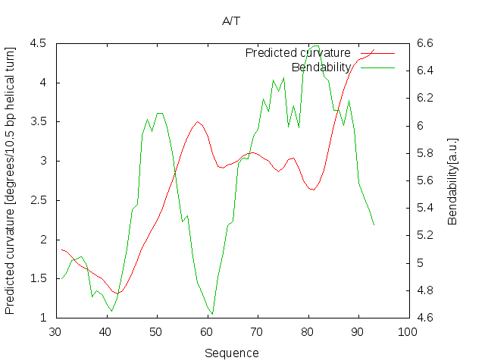
Results
PSMD9 - rs74421874: NM_002813.6:c.454-460G>A and rs3825172: NM_002813.6:c.454-437C>T
G/C
A/T
DNA secondary structure
G/C
A/T
DNA bendabilty (green line) in areal increases at change of nucleotide G/C>A/T

Slide 12
Conclusions
Meta and bioinformatic analysis of selected SNPs of PSMB8 (rs2071543, rs9357155 and rs9275596) , PSMB9 (rs17587) and PSMD9 (rs74421874 and rs3825172) illustrate possibility of using them as molecular markers of multiple sclerosis by genotyping in association study.
Notes:
Literature about chosen SNPs of PSMB8, PSMB9, and PSMD9 illustrate their potential as markers for multiple sclerosis.
Computational analyses highlight that chosen SNPs may be functionally relevant in their corresponding genes through modulating the binding of transcription factors via structural and sequence changes.

Slide 13
Thank you for your attention! ☺
SAM No 1.1.1.1/16/A/016 project “Determination of proteasome-related genetic, epigenetic and clinical markers for multiple sclerosis”

