Slide 1
The 61st International Scientific Conference of Daugavpils University
Possible functionality of genetic variations in polyA microsatellite of PSMA6 promoter in association with autoimmune disease development
in Latvians
Kristīne Dokāne, Natalia Paramonova, Ilva Trapiņa,
Kristīne Ošiņa, Nikolajs Sjakste
Notes:
1

Slide 2
Ubiquitin – proteasome system
Main non-lysosomal proteolysis pathway
UPS participates in cell cycle regulation, cell differentiation, abnormal and removal of abnormal and misfolded intracellular proteins, and generation of antigenic peptides
Gomes, A. V. (2013). Genetics of proteasome diseases. Scientifica.
Notes:
2

Slide 3
26S proteasome
Multicatalytic enzyme complex, expressed in nucleus and cytoplasm of all eukaryotic cells (~20 000 per cell);
2000 kDa; consists of 20S core and one or two 19S regulatory subunits;
Core is a cylinder consisting of two outer α and two inner β rings each made of 7 subunits (α1-α7 and β1- β7).
Gomes, A. V. (2013). Genetics of proteasome diseases. Scientifica.
Notes:
3

Slide 4
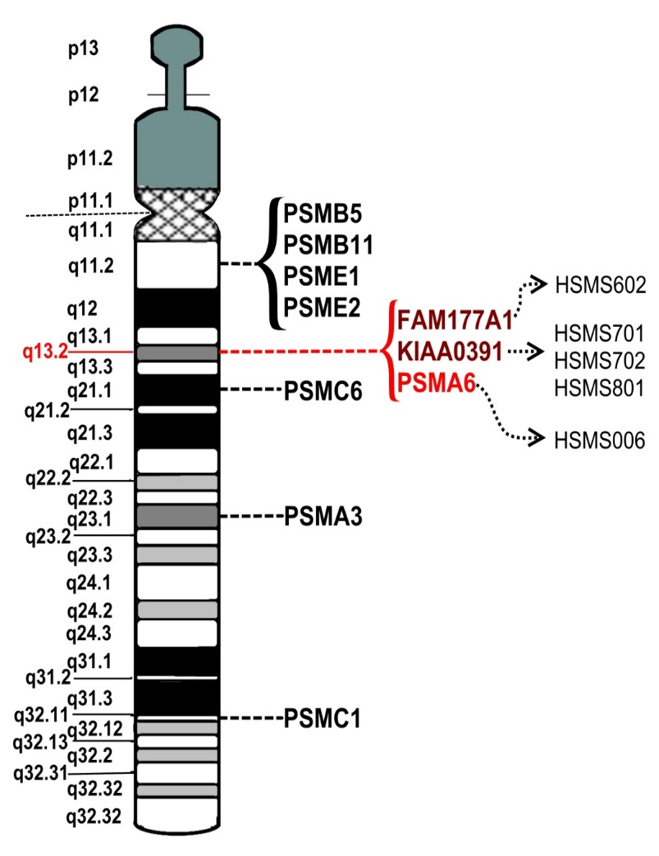
PSMA6
Proteasome subunit alpha type 6;
Human chromosome 14 region 14q13.2;
Polymorphisms in proteasomal genes, including PSMA6, have been associated with increased risk or resistance of Type 1 and 2 diabetes mellitus, Greave’s disease, juvenile idiopathic arthritis, myocardial infarction, obesity, bronchial asthma and multiple sclerosis.

Slide 5
Studied poly(dA:dT) tract

Slide 6
Sasniegtie rezultāti:
Studied poly(dA:dT) tract
Ref. (NC_000014.9)
rs113987343
PSMA6 c.-655An
GAAACTCTGTCTCAAAAAAAAAAAAAAAAAAAAAAAAGACTAAA
A = 24
(1.)
(2.)
(3.)
GAAACTCTGTCTCACACAAAAAAAAAAAAAAAAAAAACAAGACTAAA
rs200541481 (-/CA)
rs200298313 (-/C)
rs71640264 (C/A)
Notes:
6
6

Slide 7
Sasniegtie rezultāti:
Studied poly(dA:dT) tract
In previous fragment length analysis studies an association between rs200541481 and autoimmune disease susceptibility was detected.
Genotyping results have shown a complete linkage disequilibrium between rs71640264 and a juvenile idiopathic arthritis and bronchial asthma associated locus rs2277460 (PSMA6c.-110C>A)
Association between rs200298313 and autoimmune diseases have not been detected.
(1.)
(2.)
(3.)
GAAACTCTGTCTCACACAAAAAAAAAAAAAAAAAAAACAAGACTAAA
1. rs200541481 (-/CA)
2. rs200298313 (-/C)
3. rs71640264 (C/A)
Notes:
7
7

Slide 8
Aim of the current study
To evaluate the functionality of genetic variations in PSMA6 poly(dA:dT) tract in silico.
Notes:
8

Slide 9
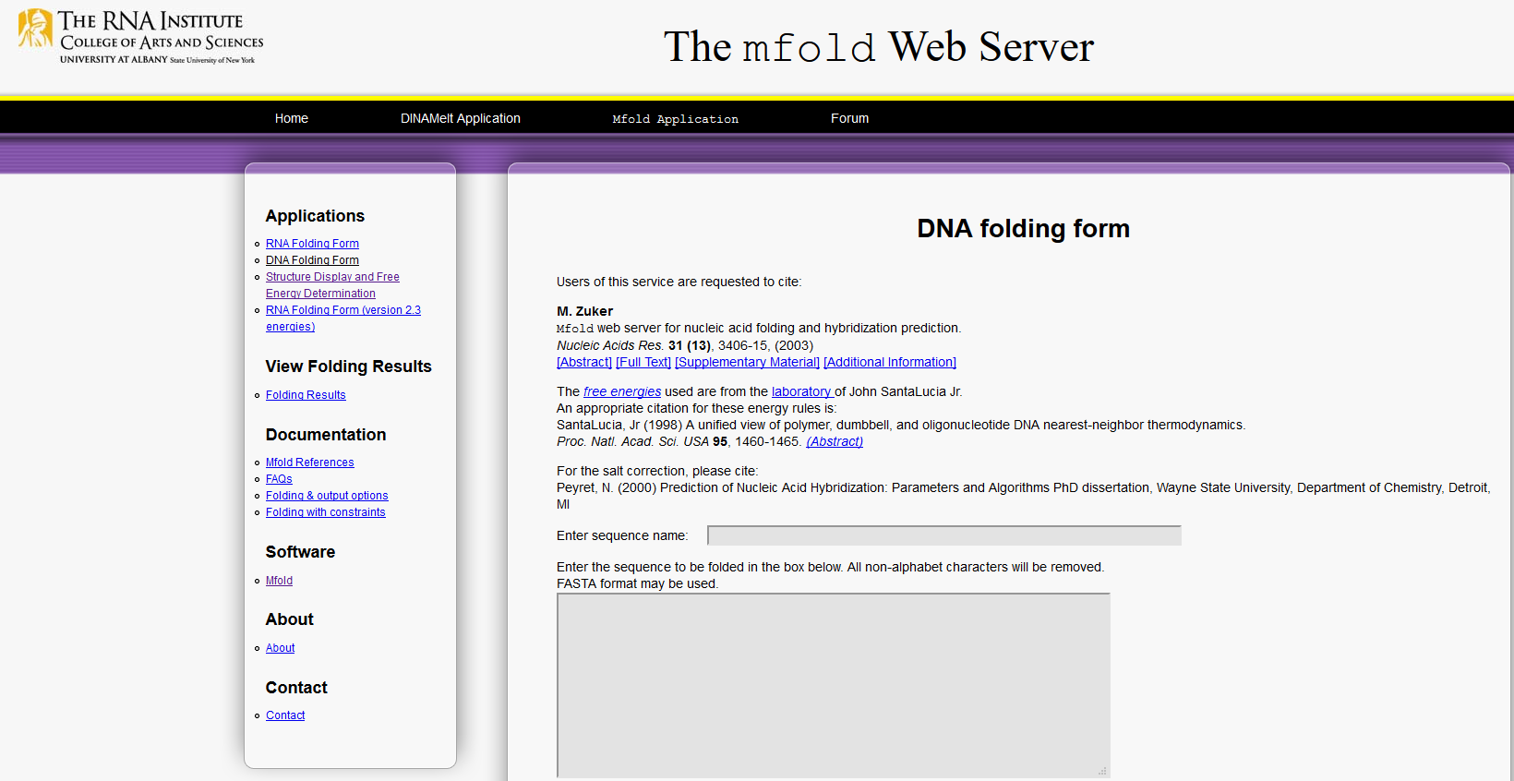
Methods
Putative transcription factor binding site analysis with MatInspector, Release 10.1 in data base Genomatix;
DNA secondary structure modeling in MFOLDROOT;
Analysis of DNA bending in bend.it
Notes:
9

Slide 10
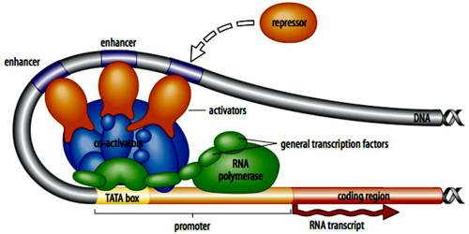
Putative transcription factor binding sites
Proteins that bind to specific DNA sequences in order to control the transcription rate of a specific gene
Notes:
10

Slide 11
Putative transcription factor binding sites
Notes:
11

Slide 12
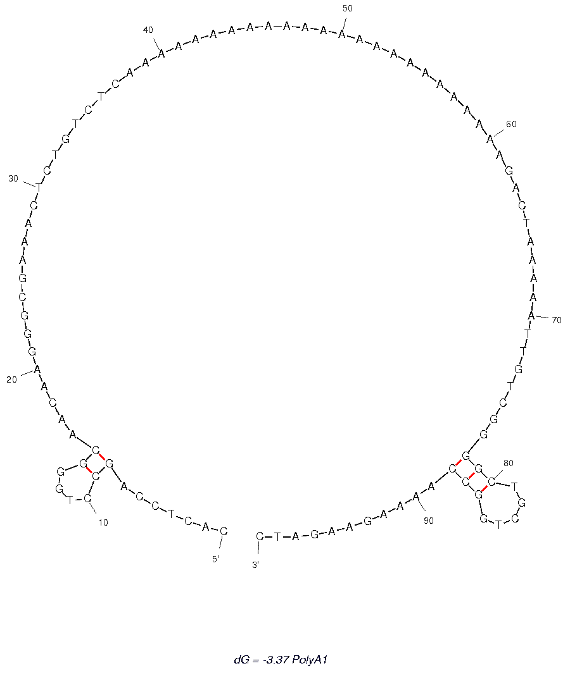
DNA Secondary structures
Important during replication and transcription;
Necessary for binding of regulatory proteins
Notes:
12

Slide 13
DNA Secondary structures
rs71640264 nukleotīds A
Important during replication and transcription;
Necessary for binding of regulatory proteins
Notes:
13

Slide 14
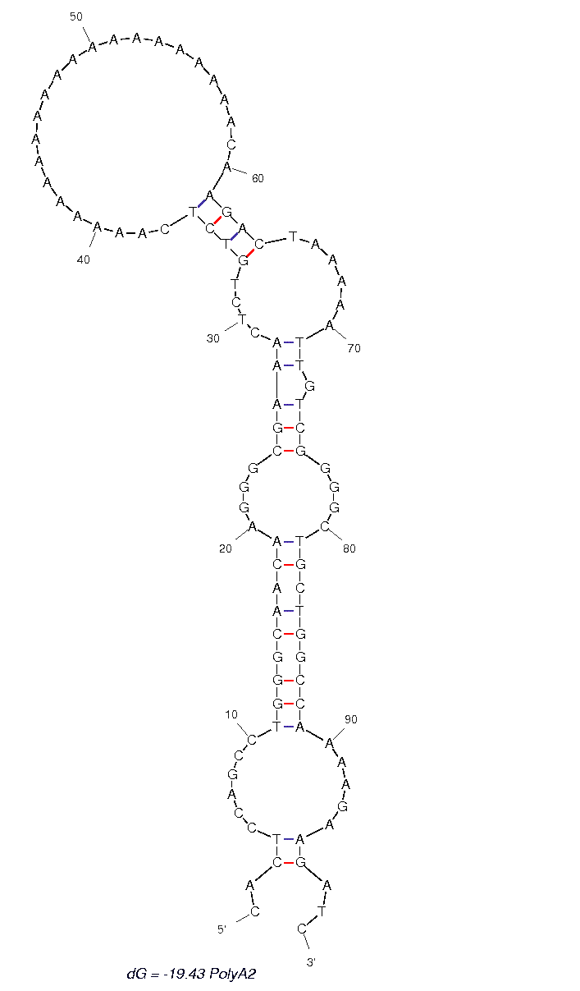
DNA Secondary structures
rs71640264 nucleotide A
rs71640264 nucleotide C
Notes:
14

Slide 15
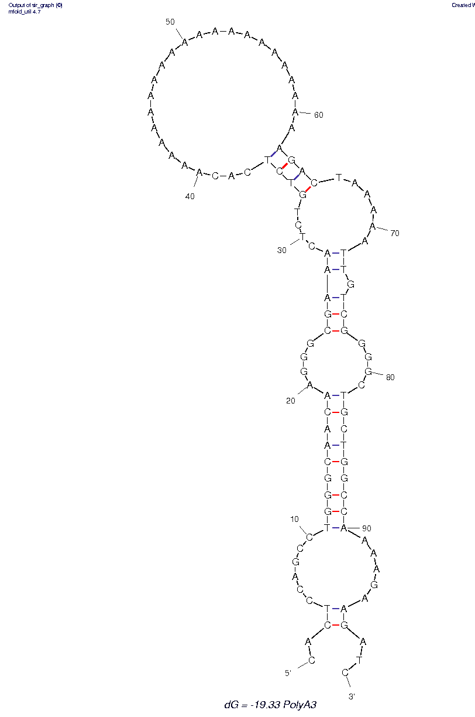
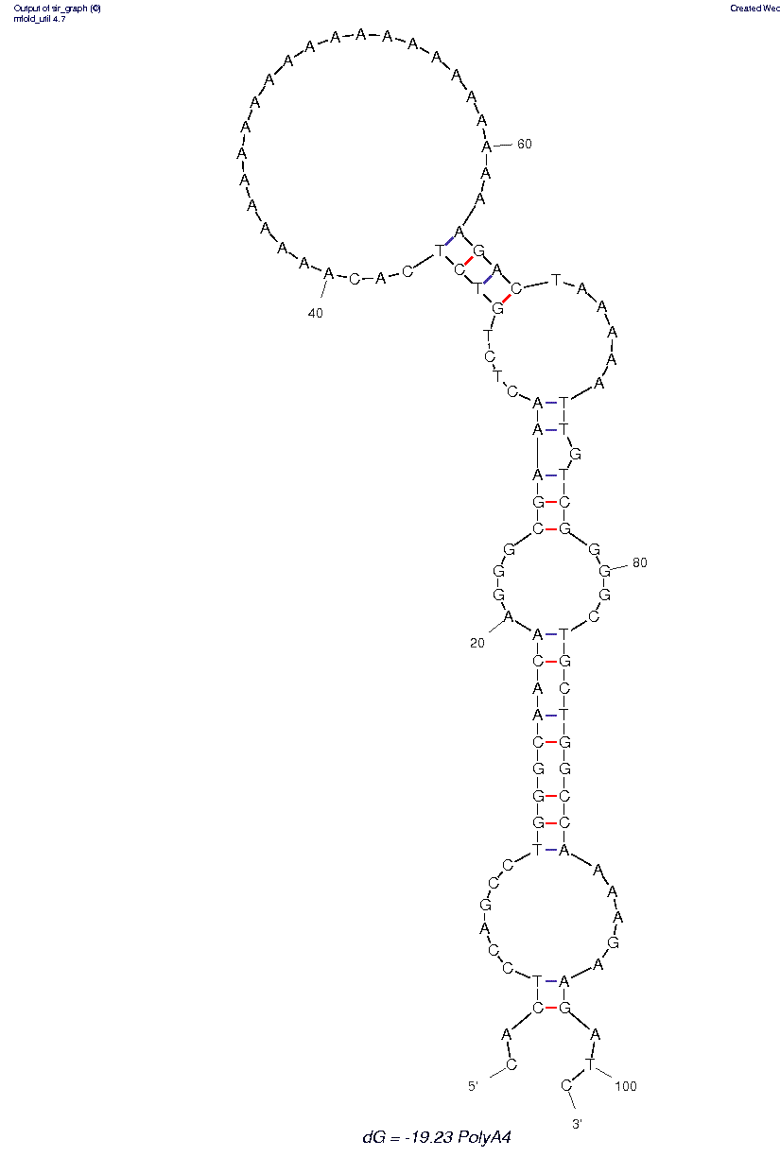
DNA Secondary structures
rs200298313
rs200541481
Notes:
15

Slide 16
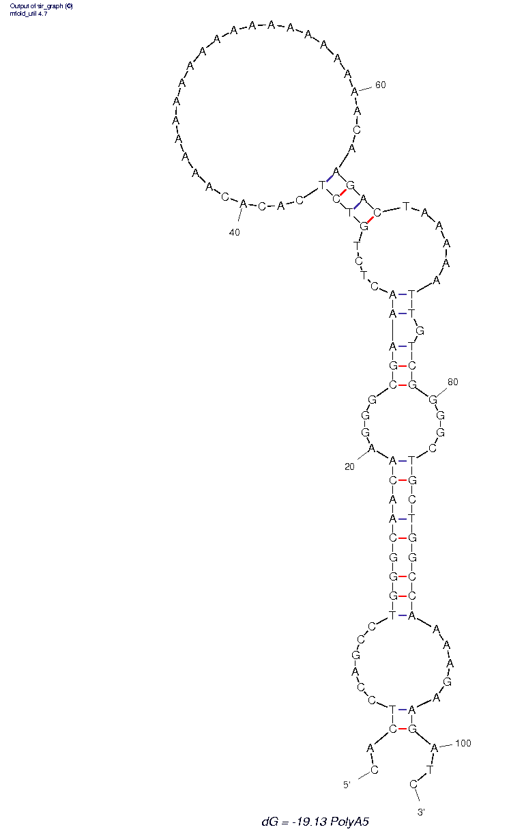
DNA Secondary structures
rs71640264
rs200298313
rs200541481
Notes:
16

Slide 17
DNA bendability and curvature
Affects nucleosome positioning, chromatin organisation and genome functioning in general;
Important for replicational and transcriptional regulation; fascilitate gene activation by nucleosome exclusion
Goodsell, D. S., Dickerson, R. E. (1994). Bending and curvature calculations in B-DNA. Nucleic Acid Research.
Segal, E., Widom, J. (2009). Poly(dA:dT) Tracts: Major Determinants of Nucleosome Organization. Curr Opin Struct Biol.
Notes:
17

Slide 18
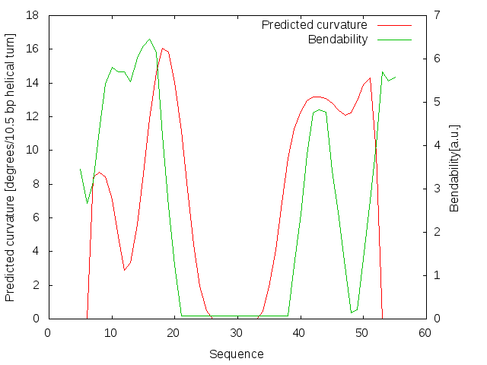
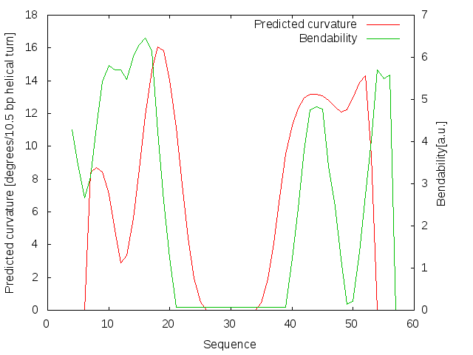
Effect of studied variations on DNA curvature and bendability
Notes:
18

Slide 19
Conclusions
In polyA tract region of PSMA6 gene promoter there are four putative transcription factor binding sites that are ot affected by studied variations.
Single nucleotide polymorphism rs71640264 (C/A) creates two new putative transcription factor binding sites (SRY and AREB6) in 3’ end of the studied polyA tract, while the studied insertions rs200541481 (-/CA) and rs200298313 (-/C) have no effect on putative transcription factor binding sites.
rs200541481 (-/CA), rs200298313 (-/C) and rs71640264 (C/A) may have a pronounced effect on DNA secondary structure thus changing binding of gene expression regulating elements.
rs71640264 (C/A) may have an effect on DNA curvature and bendability at the 3’ end of the studied polyA tract, which makes the sequence more curved and can affect the binding of gene expression regulating elements.
rs71640264 (C/A) may have an effect on disease development through functional changes both in DNA structure and mechanical characteristics as well as in putative transcription factor binding sites.
Notes:
19

Slide 20
Thank you for the attention!
The study was funded from the European Regional Development Fund project No. 1.1.1.1/16/A/016 "Identification of proteasome related genetic, epigenetic and clinical markers for multiple sclerosis”.
Notes:
20

